Slide 1
Inaugural Artificial Intelligence and Data Science Year in Review
Yuan Luo, PhD, FAMIA
Northwestern University Feinberg School of Medicine
@yuanhypnosluo
Hongfang Liu, PhD, FACMI
Mayo Clinic
@hongfangliu
#IS23

Slide 2
Disclosure
Industry: Walmart (Luo)
Funding Support: NIH
The content is solely our responsibility and does not necessarily represent the official views of our institutions or the National Institutes of Health.
Copyrights are reserved by the authors who provided the slides that we adapted from.

Slide 3
Learning Objectives
After participating in this session, the learner should be better able to:
Have a sense of the scope of AI and Data Science for health care
Summarize the state-of-the-art research in AI and Data Science for health care
Identify research and development opportunities in this space and advance the field

Slide 4

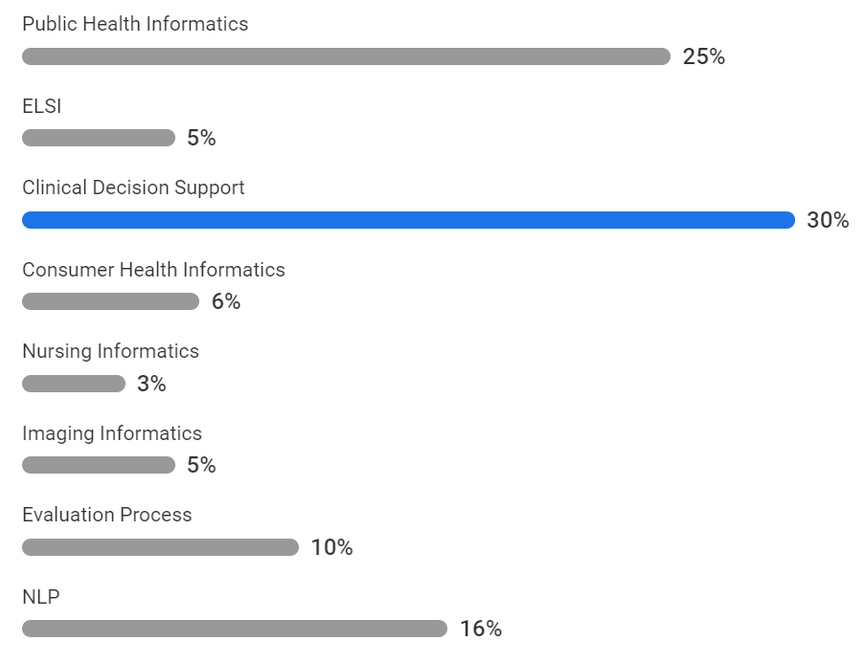

What best describes your interest (select one)?
ⓘ Start presenting to display the poll results on this slide.

Slide 5
Process and caveats
The content is developed by the informatics community, for the informatics community, we are not boiling the ocean
Teamwork makes dreamwork, we thank talented volunteers from JAMIA and JBI student editorial boards++ (Brian Tran, Hong Sun, Xinmeng Zhang, Joshua Anderson, Yikuan Li, Elaine Sang, Hanyin Wang, Meghan Hutch), generous help from Jim Cimino
Each volunteer picked a topic, for which they were asked to nominate papers that are significant (new model, new insights, new task)
Focused on original research of AI and data science for health care, exclude reviews, viewpoints …
I picked “interesting” ones to request audiovisual materials from authors
Hongfang and I finalized the selection, organized the slides and divide-and-conquer the presentation
Apologies for things I missed or misjudged, mistakes are all mine

Slide 6
Topics
Public and Global Health Informatics
Ethical, Legal and Social Issues
Clinical Decision Support
Consumer and Pervasive Health Informatics
Nursing Informatics
Imaging Informatics
Natural Language Processing
Evaluation and Implementation

Slide 7
Public and Global Health Informatics

Slide 8
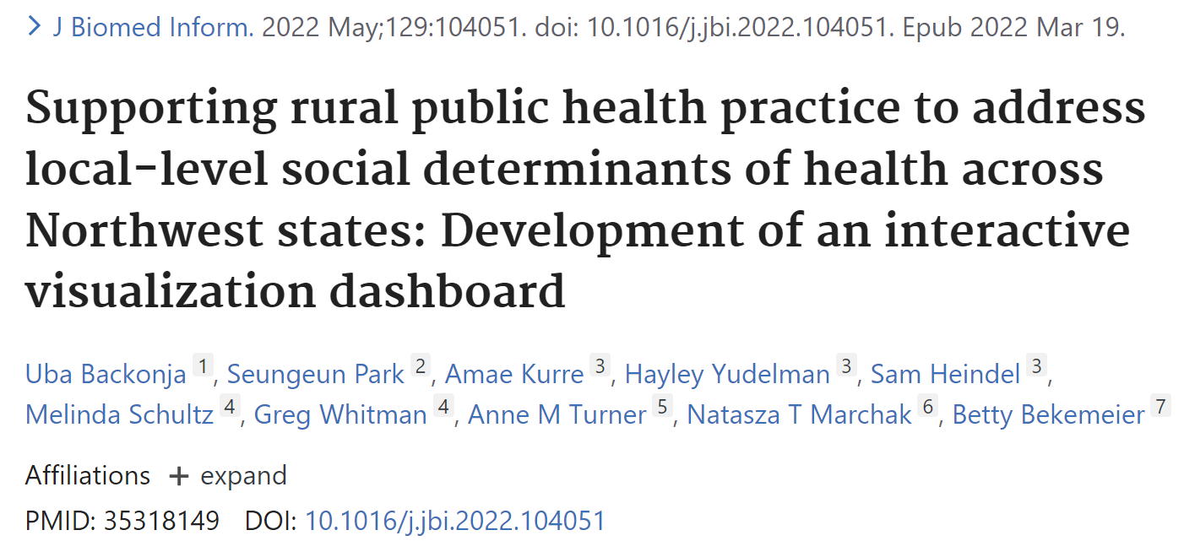
Public and Global Health Informatics

Slide 9
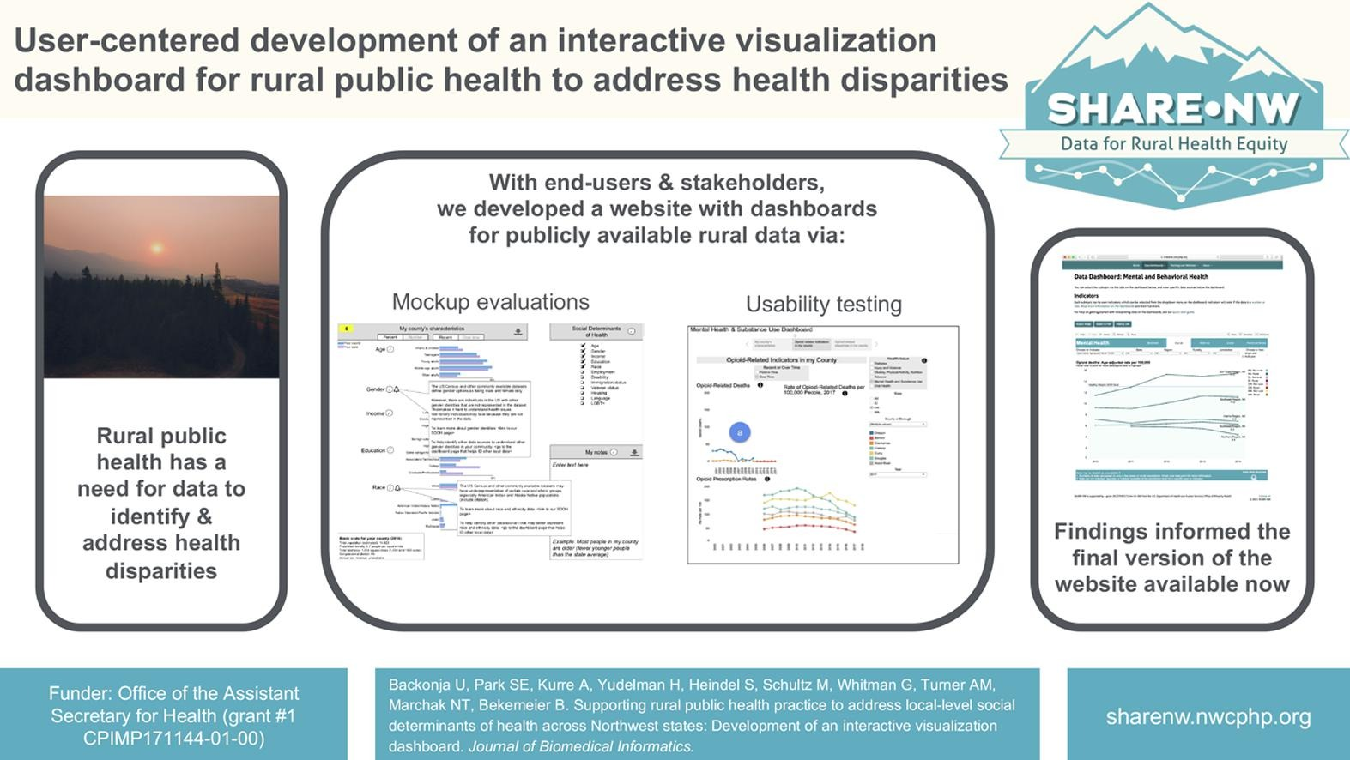
Supporting rural public health to address health disparities
Notes:
The authors sought to expand public health informatics solutions to mitigate health related disparities in rural communities across Northwestern US states– a geographical area which often has limited resources to combat health disparities. - The study adapted a user-centered design approach to develop a dashboard that provided the data access needed by healthcare practitioners in rural settings to identify and address public health needs and disparities. - Implemented feedback from users to optimize and guide dashboard development to meet the needs of rural healthcare practitioners.
[- The authors developed a dashboard in the following stages: 1) conversed with public health practitioners to assess public health needs of the community and identified relevant data sources that could serve as indicators of each health priority. 2) Used a paper mockup to assess dashboard usability by healthcare practitioners and to determine which design elements were helpful or unhelpful. 3) Developed a functional testing website and assessed usability among a team of testers. ]

Slide 10
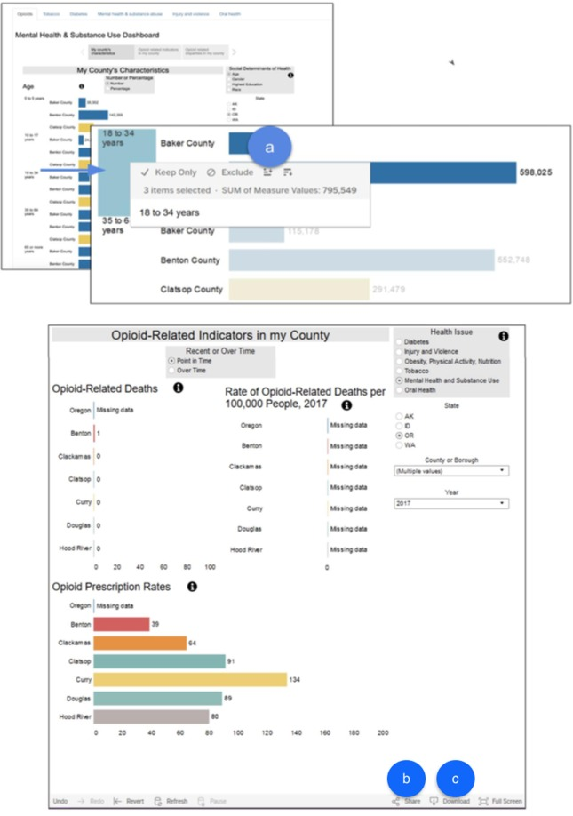
Supporting rural public health to address health disparities
Lesson learned example:
During usability testing of the alpha SHARE-NW website, participants had trouble finding (a) the sort function in the Tableau dashboard and (b) the share and (c) download buttons.
Notes:
They used Munzner’s model helped us identify a big threat to the usability of the dashboard: the high computational requirements of rendering complex visualizations on Tableau (related to the algorithm layer of the model). Rural public health departments often have (1) slow internet access due to disparities in broadband access in rural communities and, as we heard from participants, (2) older computers that have limited processing capacity.

Slide 11
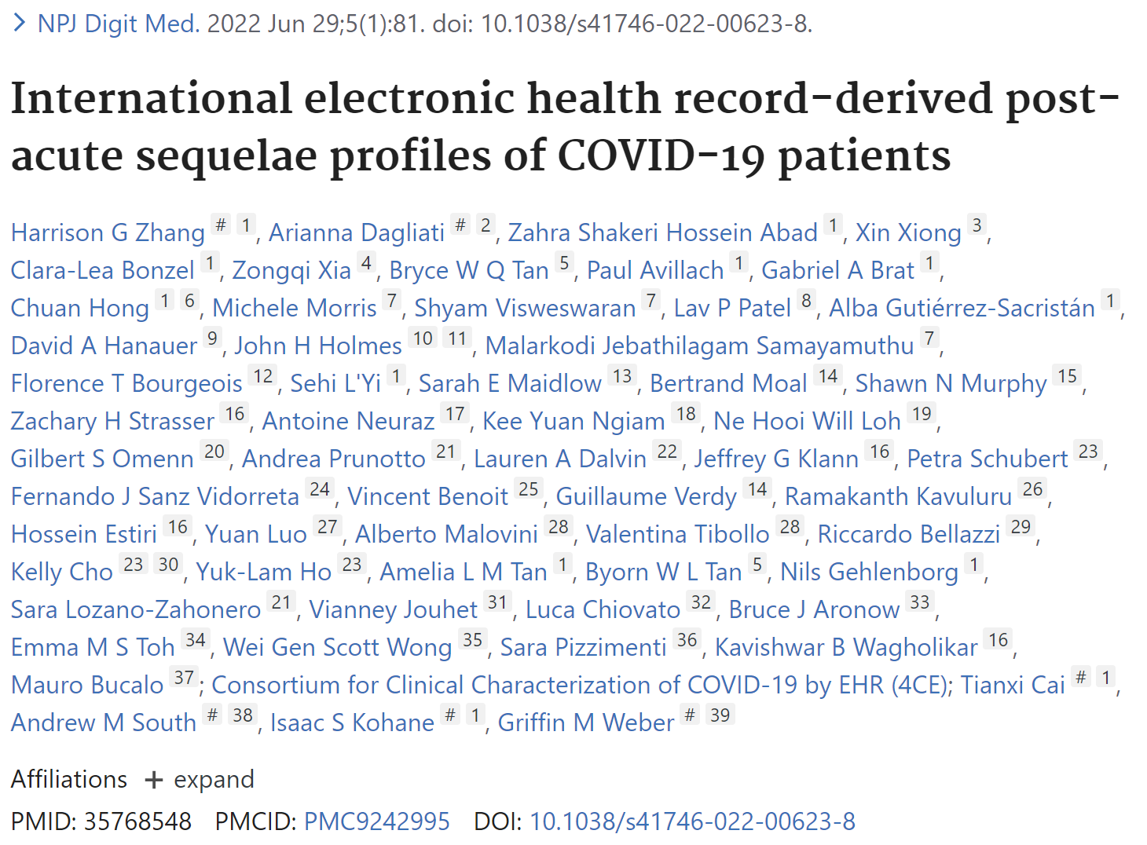
Public and Global Health Informatics

Slide 12
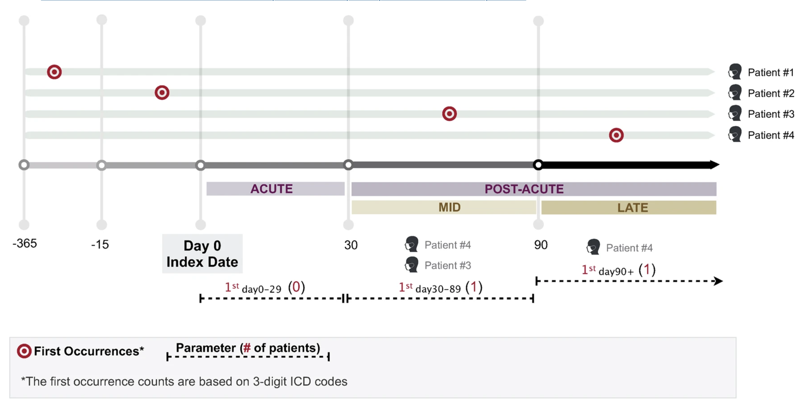

International EHR-derived Long COVID profiles of COVID-19 patients
Identified incident annotations of phenotypes (use ICD codes) in a federated network of 277 international hospitals
Estimated relative risk of phenotypes among COVID-19+ patients (n=414,602) relative to non-infected patients (n=2,300,000) at:
30 days after index date
90 days after index date
Notes:
Electronic health record data from 277 hospitals across five counties (France, Germany, Italy, Singapore, and the US), were used to evaluate the risk profiles of post-acute sequelae of COVID-19 (PASC or long-COVID). All data was obtained from hospitals participating in the federated, multinational Consortium for Clinical Characterization of COVID-19 by EHR (4CE).
[- ICD codes were mapped to PheCodes and the cumulative incidence of different conditions were compared between COVID-19 and comparable non-COVID-19 controls. Conditions from multiple organ systems (e.g. cardiovascular, dermatologic, metabolic, neurologic, pulmonary, sensory, etc.) were evaluated. - The study also evaluated temporal changes in the cumulative incidence of conditions over the calendar year (Jan 1, 2020 – March 30, 2021). ]

Slide 13
Diseases with increased risk in COVID-19 outpatients
Using a federated international network, the authors systematically identified robust conditions associated with PASC compared to control groups, underscoring the multifaceted cardiovascular and neurological phenotype profiles of Long COVID
Notes:
Specifically, COVID-19 patients who were hospitalized were found to be at an increased risk for new cardiac and neurological sequalae, including heart failure, delirium, and cognitive dysfunction/altered mental status.

Slide 14
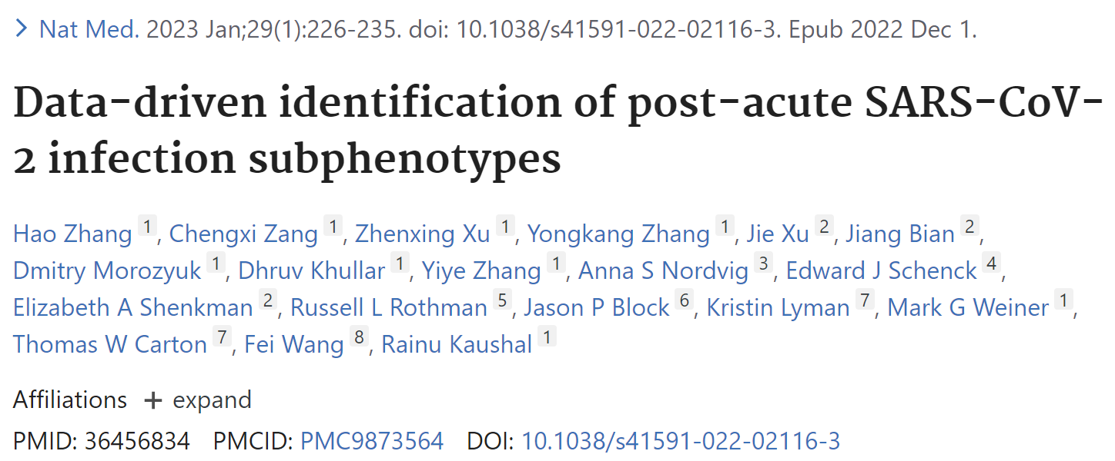
Public and Global Health Informatics

Slide 15
Identifying long-COVID subphenotypes
Zhang H et al, Data-driven identification of post-acute SARS-CoV-2 infection subphenotypes. Nat Med. 2023 Jan;29(1):226-235.
Notes:
- This study analyses of over 137 symptoms and conditions, and identified four reproducible post-acute sequelae of SARS-CoV-2 infection post-acute sequelae of SARS-CoV-2 infection (PASC) subphenotypes. - It provides insights into the heterogeneity of PASC and may inform stratified decision-making in the management of PASC conditions

Slide 16
Identifying long-COVID subphenotypes
Notes:
- Most studies of its kind have examined these conditions individually without providing evidence on co-occurring conditions. This study leveraged the electronic health record data of two large cohorts. - This study leveraged a topic modeling (TM) approach to learn the co-incidence patterns, which is more appropriate compared to methods like principal component analysis (PCA). - This study is performed in distinct geographic regions and their study period covers multiple SARS-CoV-2 virus variants.

Slide 17
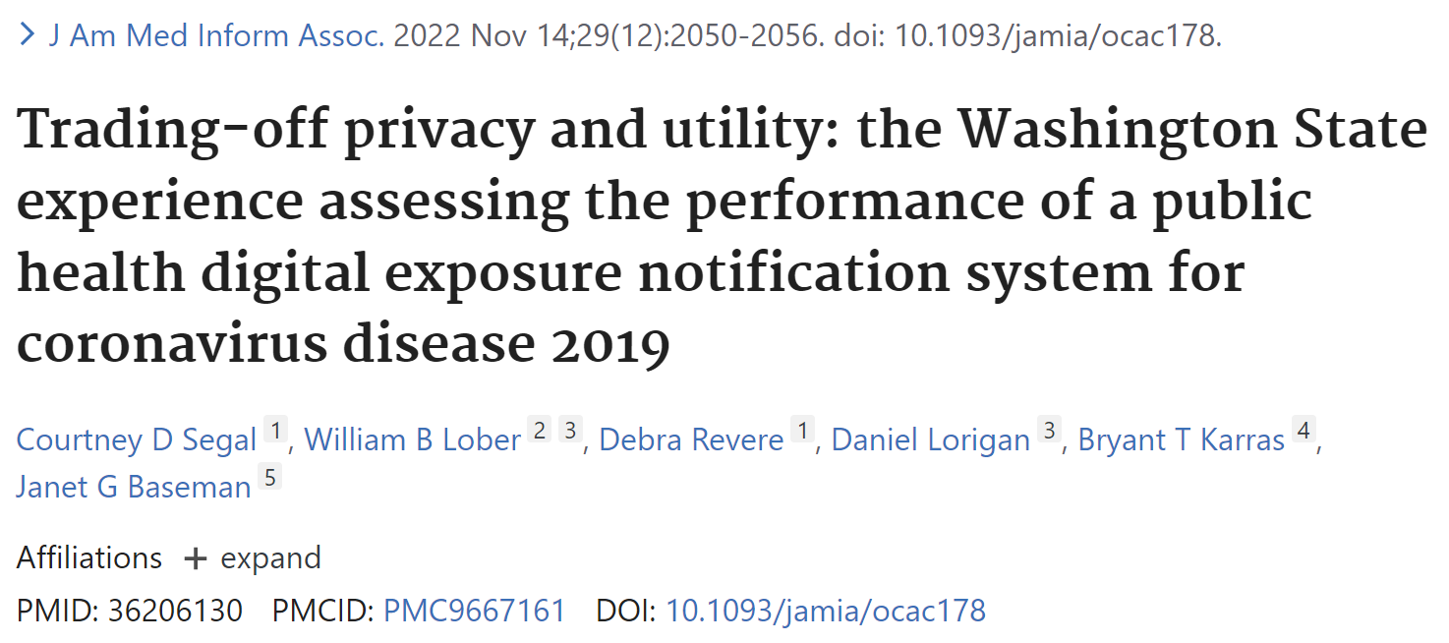
Public and Global Health Informatics

Slide 18
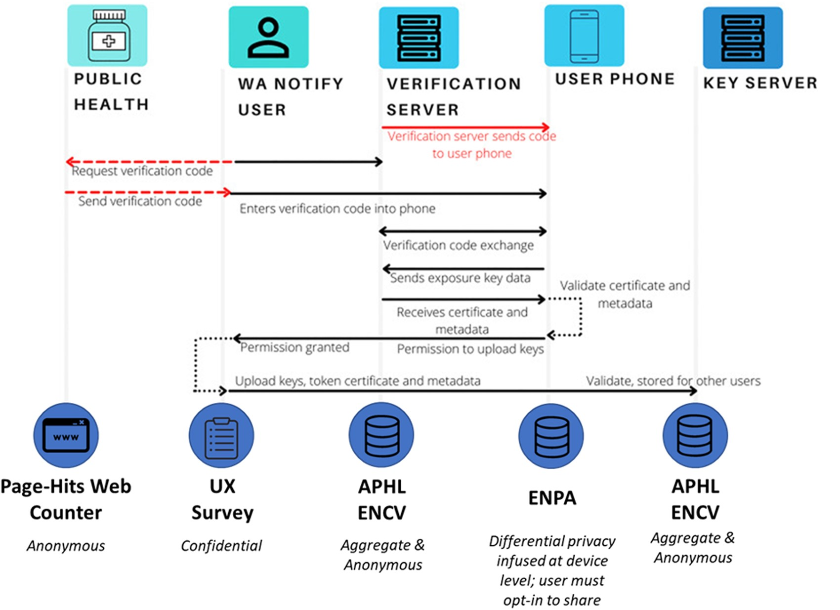
Digital Exposure Notifications Trading-off privacy and utility: the Washington State experience
Notes:
Objective: Identify Performance Measures for Digital Exposure Notification (DEN) tools
Develop meaningful metrics from disparate, deidentified, aggregate data infrastructure
We conducted an environmental scan of DEN documentation and relevant publications. Participation in multidisciplinary collaborative environments facilitated shared learning. Compilation of available data sources and their relevance to implementation and operation workflows were synthesized to develop implementation evaluation constructs.

Slide 19
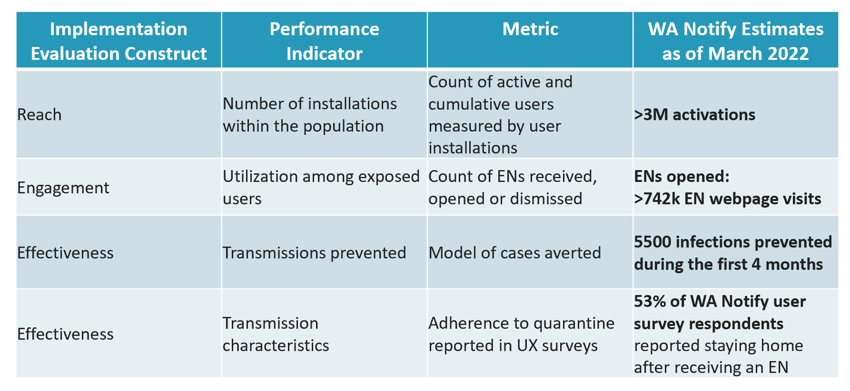
Digital Exposure Notifications Trading-off privacy and utility: the Washington State experience
Notes:
They identified 8 useful performance indicators within reach, engagement, and effectiveness constructs.

Slide 20
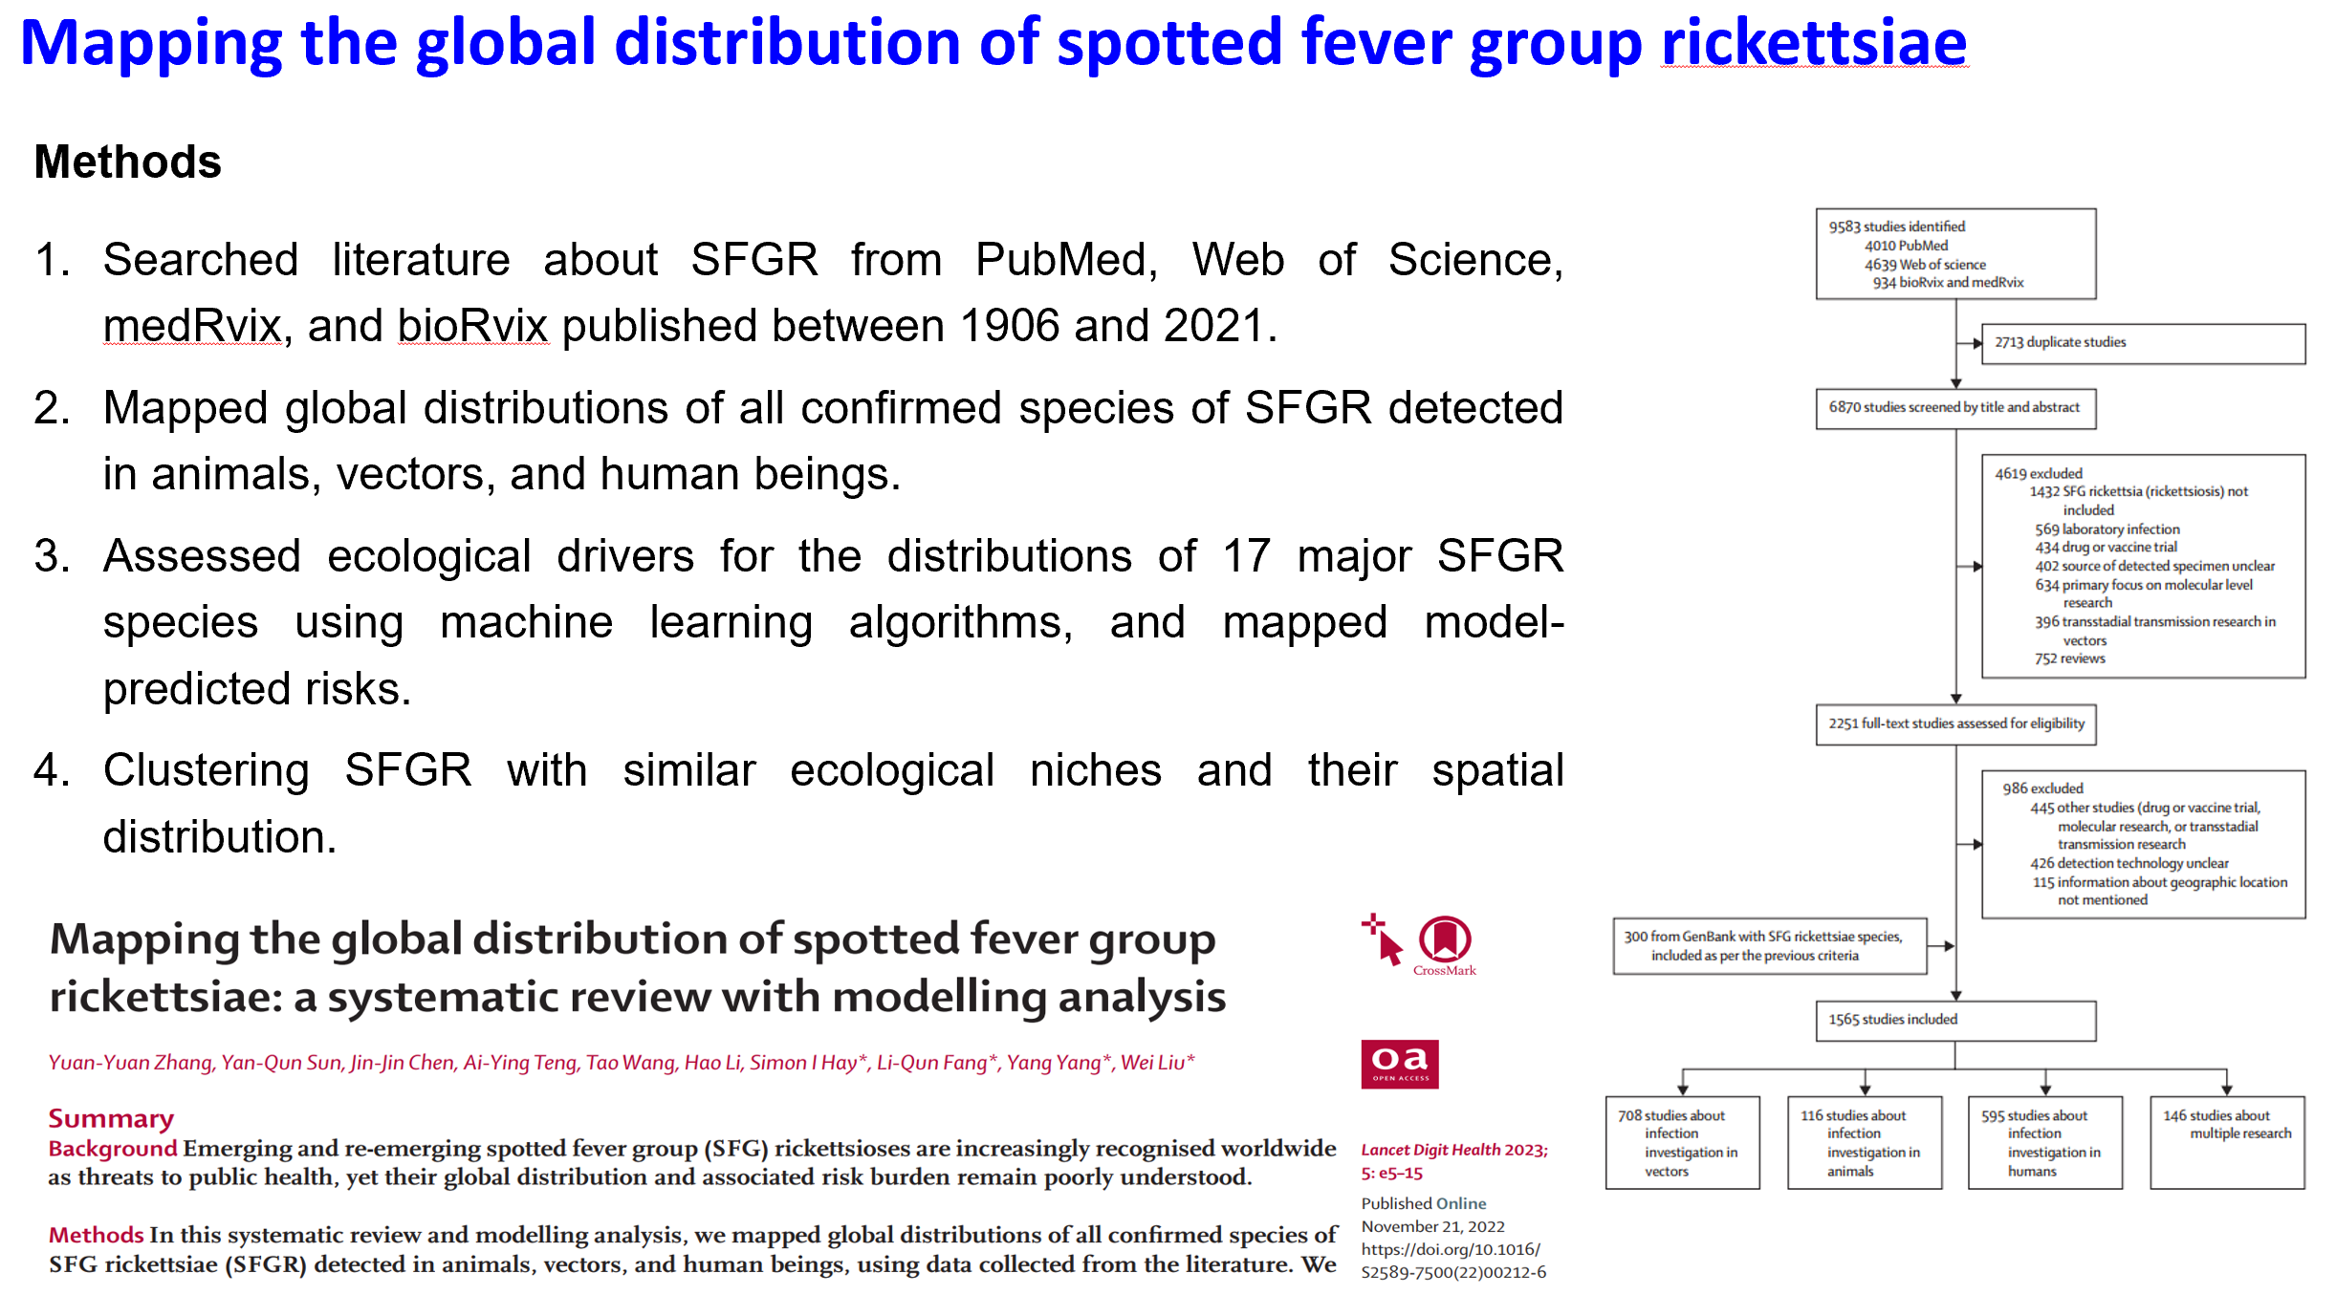
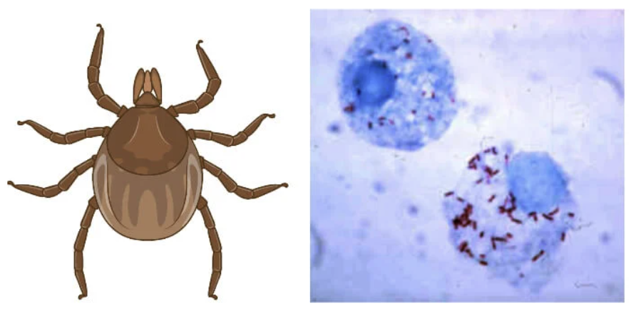

BUGS!!!
Notes:
Systematic review and meta-analysis have long been adopted in global health research for aggregating existing studies. While they can synthesize existing evidence, additional insights from published studies can be unlocked by extra steps of curating published studies and further modeling analysis. Zhang and colleagues showcased that this is both feasible and beneficial by systematically reviewing, geolocating and modeling published studies on spotted fever group (SFG) rickettsioses in order to map the risks at the global scale

Slide 21
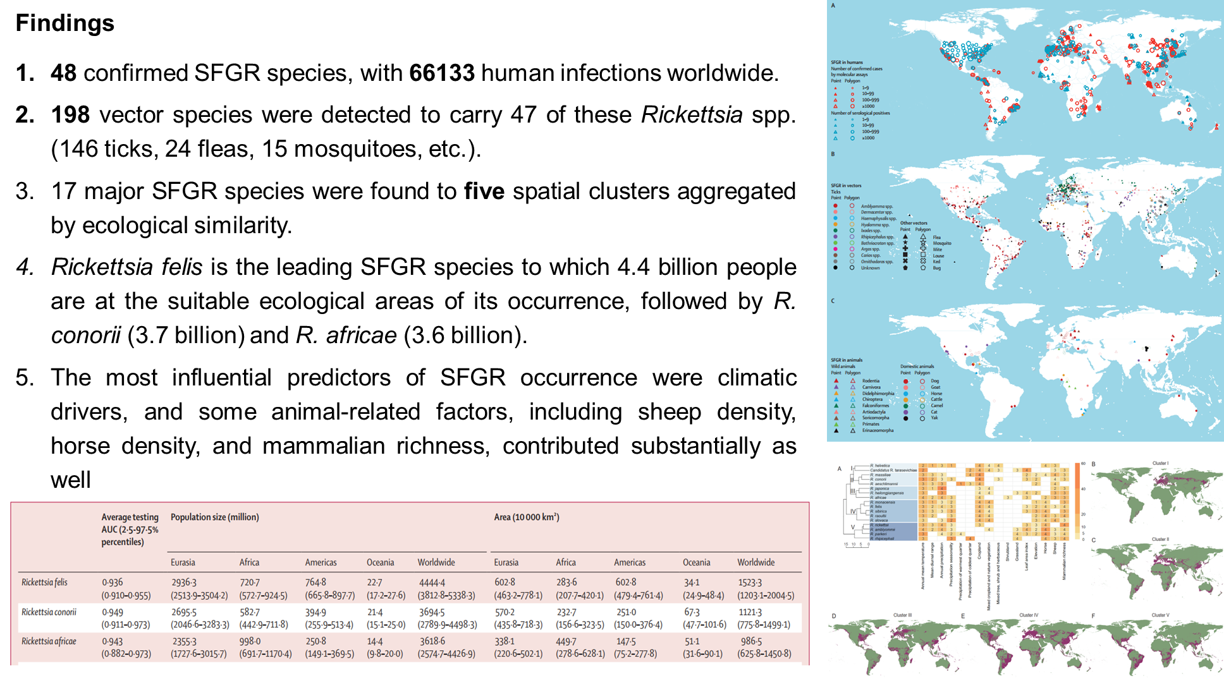
Mapping the global distribution of spotted fever group rickettsiae
Notes:
Notably, the authors used geo-positioning to augment the reviewed studies with occurrence locations for studying geographical distribution patterns of rickettsiae species, vectors, and their impact on clinical presentations. The fresh insights on disease transmission, spread and outbreaks would be otherwise difficult to obtain but for the augmented spatial data.
Another notable feature of this study is using machine learning to inform surveillance and guide targeted data collection. The authors predicted the risk of potential SFGR occurrences at locations with little or no epidemiological investigation to guide future field investigation and surveillance.

Slide 22
Ethical, Legal and Social Issues

Slide 23
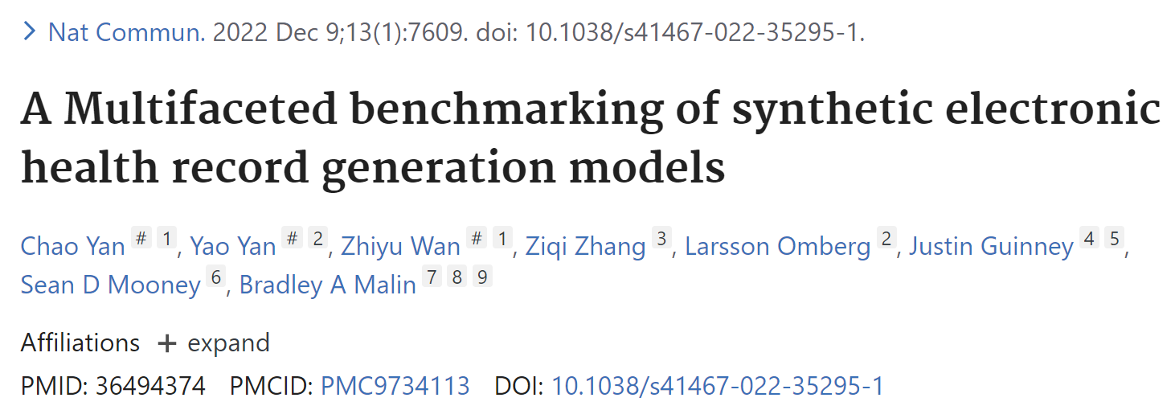
Ethical, Legal and Social Issues

Slide 24
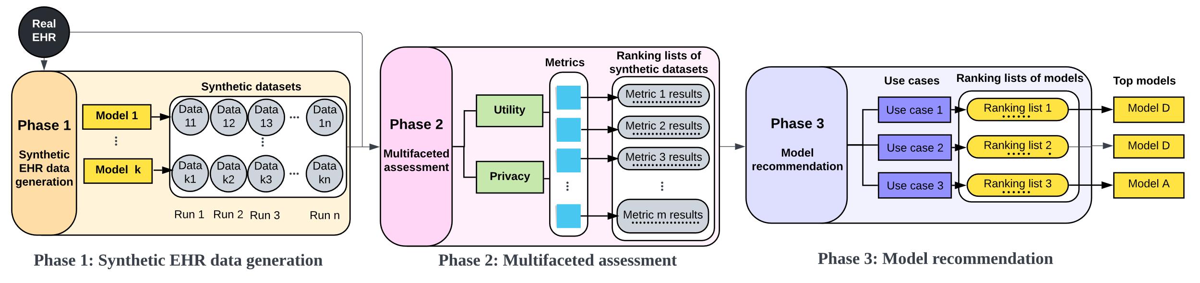
Multifaceted benchmarking of synthetic EHR generation
Synthetic EHR data generation:
A solution to broaden data sharing at scale
Retain statistical nature of real data while protecting privacy
Status quo:
A lack of consensus on synthetic EHR data evaluation
A disconnection between evaluation to use cases
Notes:
Generating synthetic version of electronic health record (EHR) data has garnered an increasing amount of attention as a solution to enable the broad use of patient data at scale, which can maximize the value of EHR data to improve biomedicine and healthcare. Synthetic EHR data, when appropriately generated, can retain the statistical structures of the real EHRs on which they are based while dissolving the connections to real patients.
However, there is a lack of consensus on the evaluation metrics that should be applied to assess synthetic EHR data. There is also a disconnection between evaluation and use cases.
In this work, they introduce a multifaceted and use-case customizable benchmarking framework to evaluate synthetic EHR generation models in a systematic manner. The framework contains 3 phases: 1) synthetic EHR data generation phase, 2) multifaceted assessment phase, and 3) model recommendation phase.

Slide 25
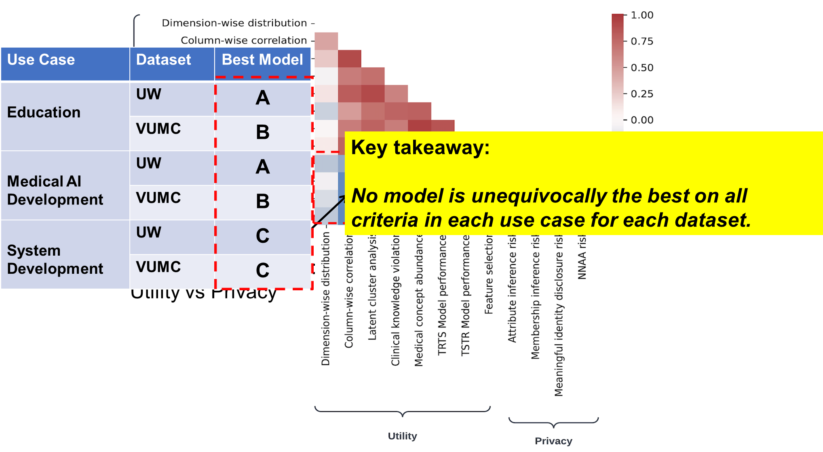
Multifaceted benchmarking of synthetic EHR generation
Notes:
Based on the real EHR datasets extracted from Vanderbilt and UW, they found that privacy-utility tradeoff is evident in synthetically generated data from the fact that all pairs of utility and privacy metrics were negatively correlated.
They consider three use cases of synthetic EHR data for further evaluation: education, medical AI development and system/software development. Each use case has their own data users and demand on what aspect of data should be preserved.
The key takeaway is no model is unequivocally the best on all criteria in each use for each dataset.
This illustrates why synthetic data generation models need to be systematically assessed in the context of their use case before their application.

Slide 26
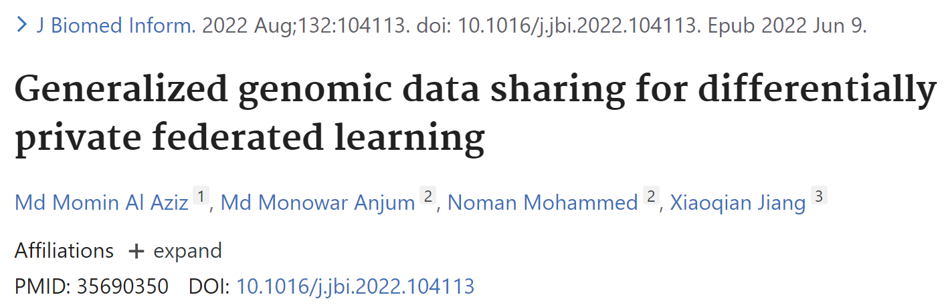
Ethical, Legal and Social Issues

Slide 27
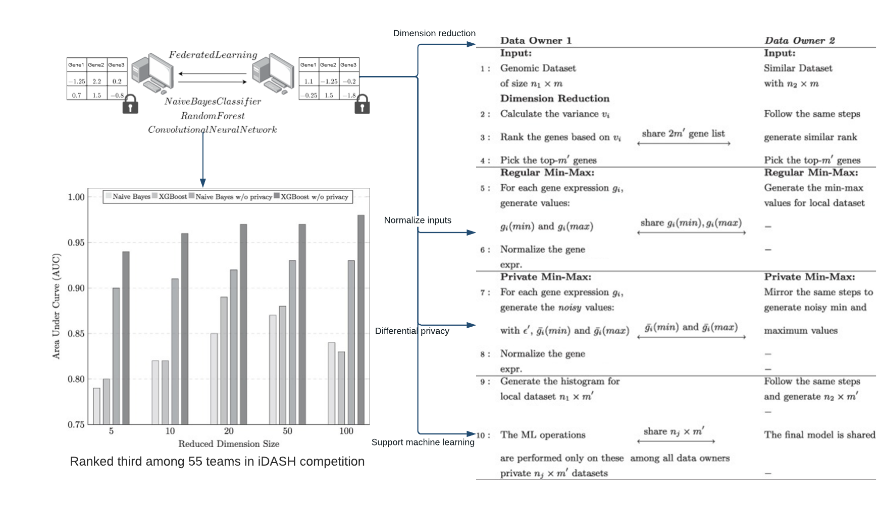
Private Federated Learning for Genomic Data
Notes:
The authors propose a generalized gene expression data sharing method using a differentially private mechanism. Due to the large number of genes available, the data dimension is also reduced to accommodate smaller privacy budgets as they utilize an exponential mechanism to create a private histogram from numeric expression data. The output histogram can be used in any federated machine learning setting having multiple data owners. The experimental results show that it takes around 8 s to train a model while achieving 0.89 AUC using a small privacy budget.

Slide 28
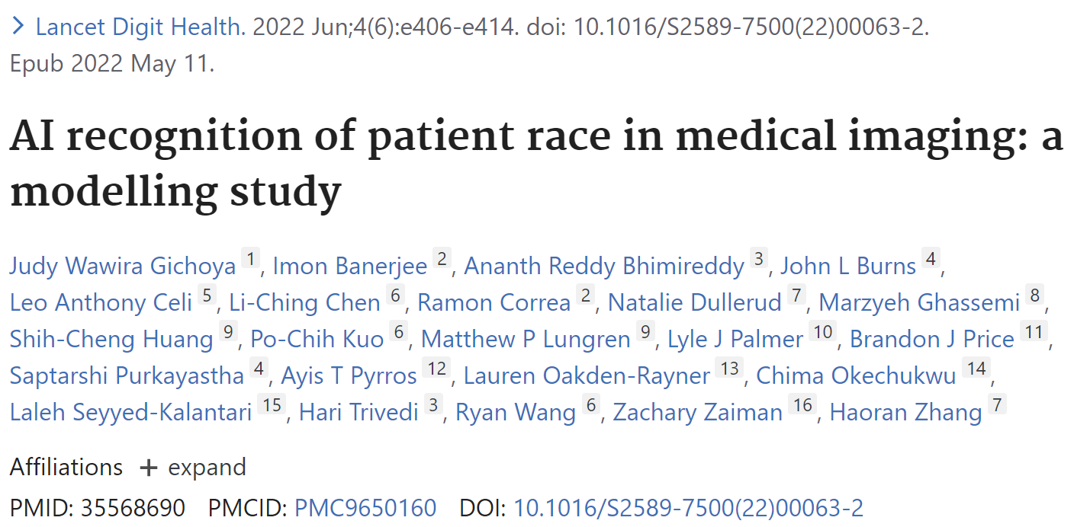
Ethical, Legal and Social Issues

Slide 29
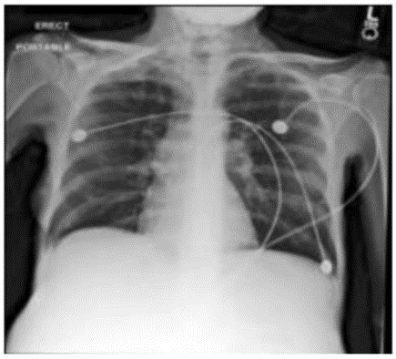
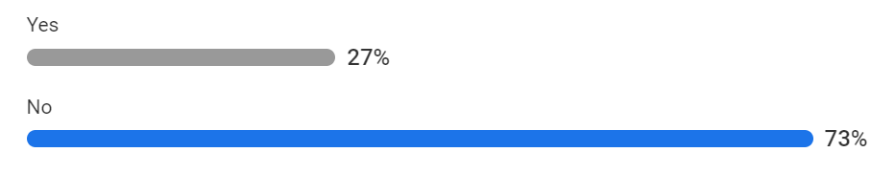
Pop Quiz!
Is this patient Black?
ⓘ Start presenting to display the poll results on this slide.

Slide 30
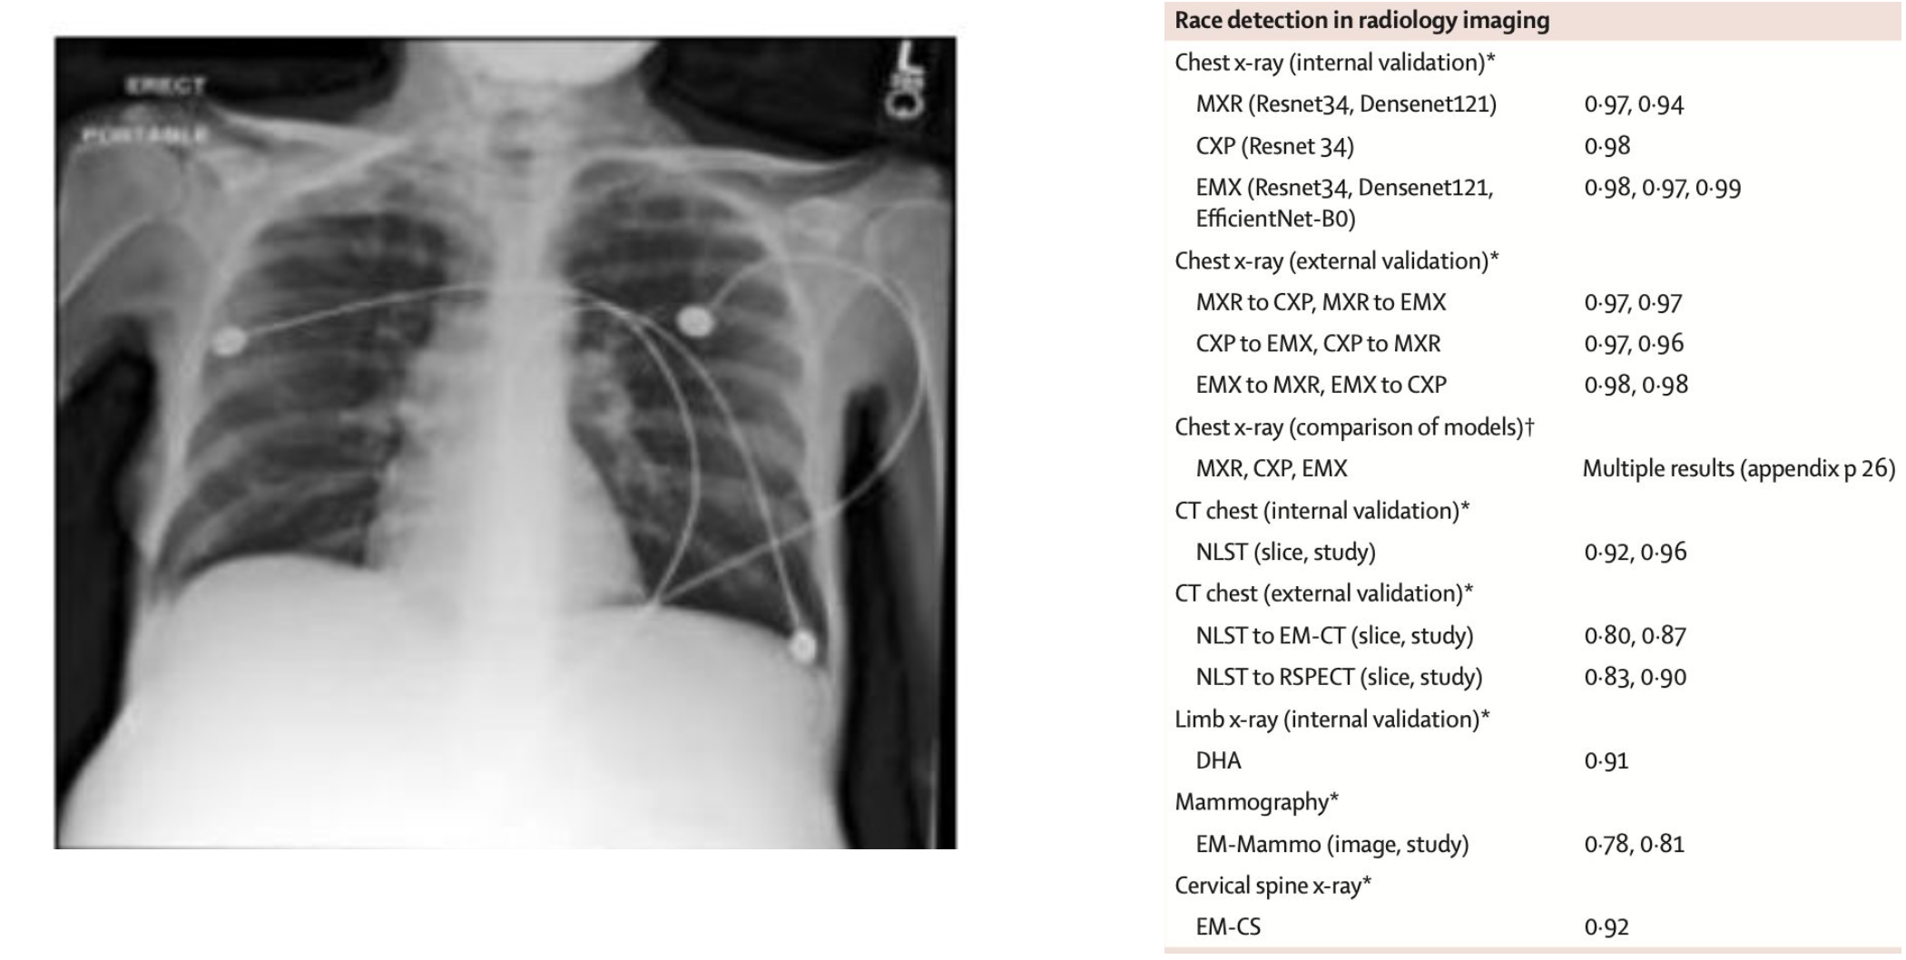
Pop Quiz!
Is this patient Black?

Slide 31
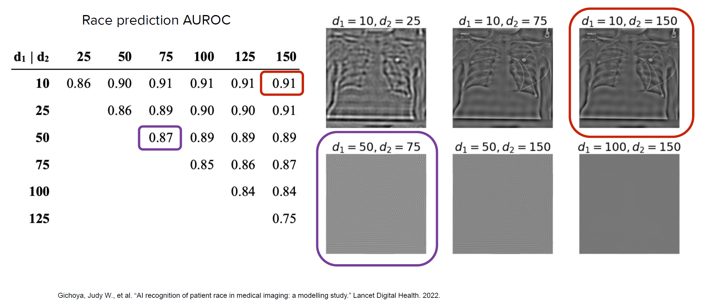
Self-reported Race is Obvious to AI
Notes:
they tested the effect on model performance of adding a low-pass filter and a high-pass filter for various diameters
band-pass

Slide 32
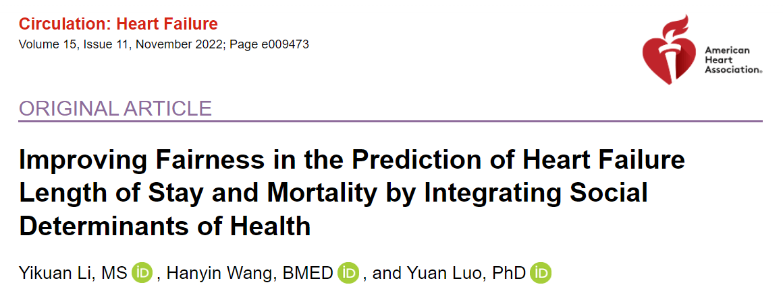
Improving fairness in the prediction of HF patient outcomes
210,368 HF patients extracted from the Get With The Guidelines-Heart Failure (GWTG-HF) registry
Hospitalization LOS and in-hospital mortality
Stratified underdiagnosis and overdiagnosis rates
Notes:
Underdiagnosis (false negative rate) and overdiagnosis (false positive rate)
Medicare is a medical insurance program for people over 65 and younger disabled people and dialysis patients. Medicaid is an assistance program for low-income patients' medical expenses.

Slide 33
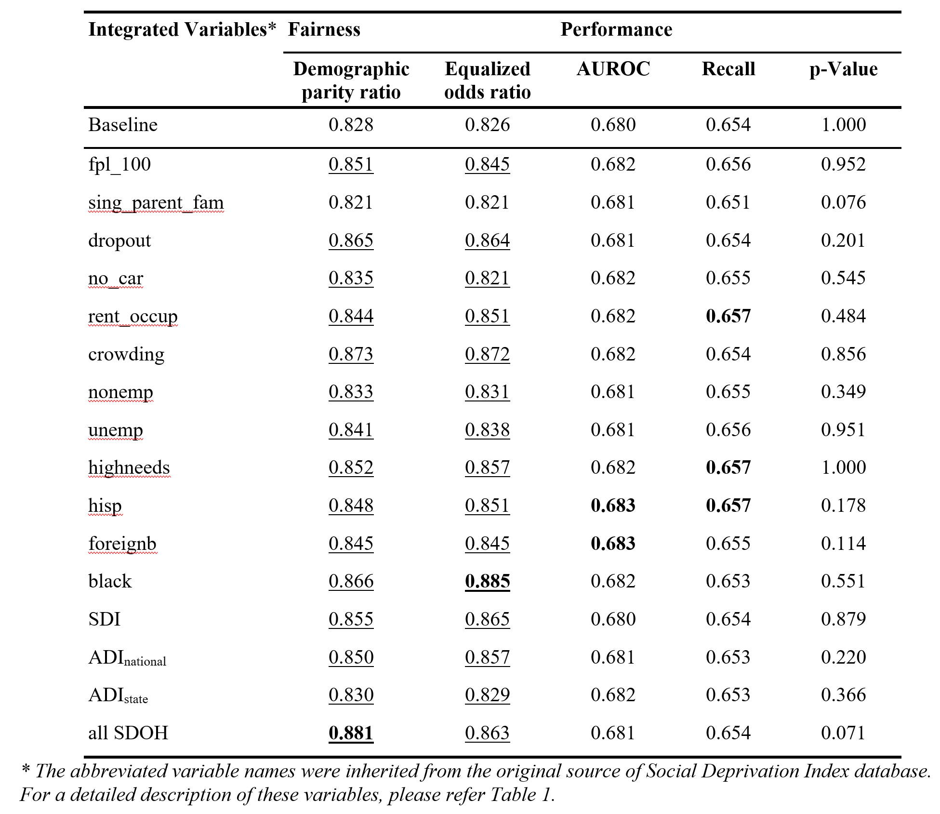
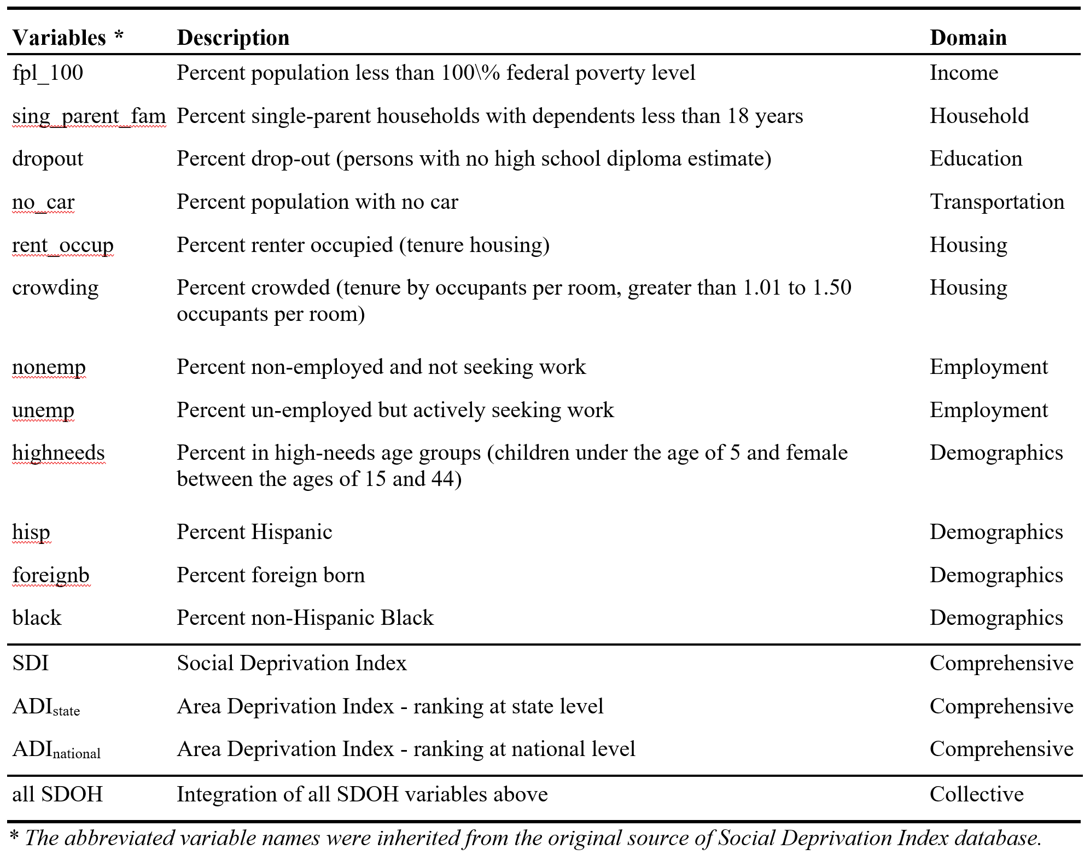
Improving fairness in the prediction of HF patient outcomes
Notes:
Social Deprivation Index (SDI) ²⁵ and Area Deprivation Index (ADI) ²⁶. Both indexes are composite measures of deprivation collected from the American Community Survey. SDI reflects the socio-economic variation in health outcomes of differing geographies. The SDI index as well as its constructs covers a broad range of SDOH, including housing, income, education, employment, transportation, community demographics and others. ADI provides standardized rankings for census blocks by socioeconomic disadvantage at both state and national levels. ADI is derived from the theoretical domains of income, education, employment, and housing quality. Both SDI and ADI depict the community-level social determinants of health and have been broadly applied to reducing health costs ^{27,28}, improving health quality ^{29,30}, and investigating health inequity ^{31,32}
The demographic parity ratio is defined as the ratio of the smallest and the largest group-level selection rates across all ethno-racial groups.
Equalized odds ratio is defined as the smaller between the recall ratio and the false negative rate ratio. The equalized odds ratio of 1 means that all groups have the same true positive, true negative, false positive, and false negative rates.
The impact of fairness and performance when integrating each SDOH variables into the feature space of random forest classifier. Each integrated model was compared to the baseline model (the model without any SDOH integrated). McNemar's test was also used to compare the difference of proportion of errors between the baseline and the SDOH integrated models. The fairness score is underlined if we observe improvement on fairness when compared with the baseline model. The highest score for each metric is bold.

Slide 34
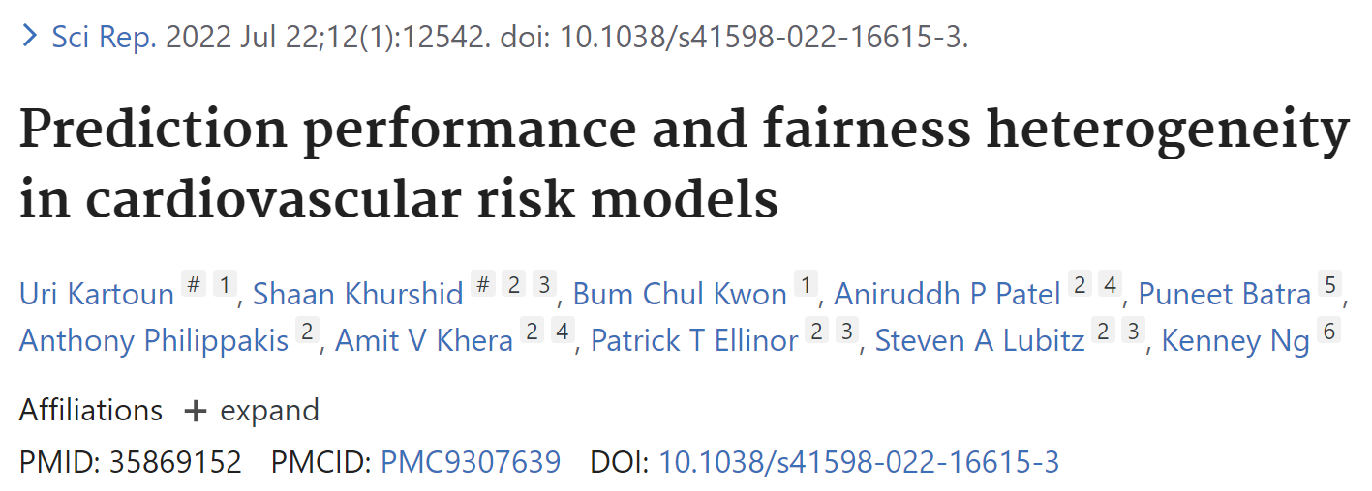
Ethical, Legal and Social Issues

Slide 35
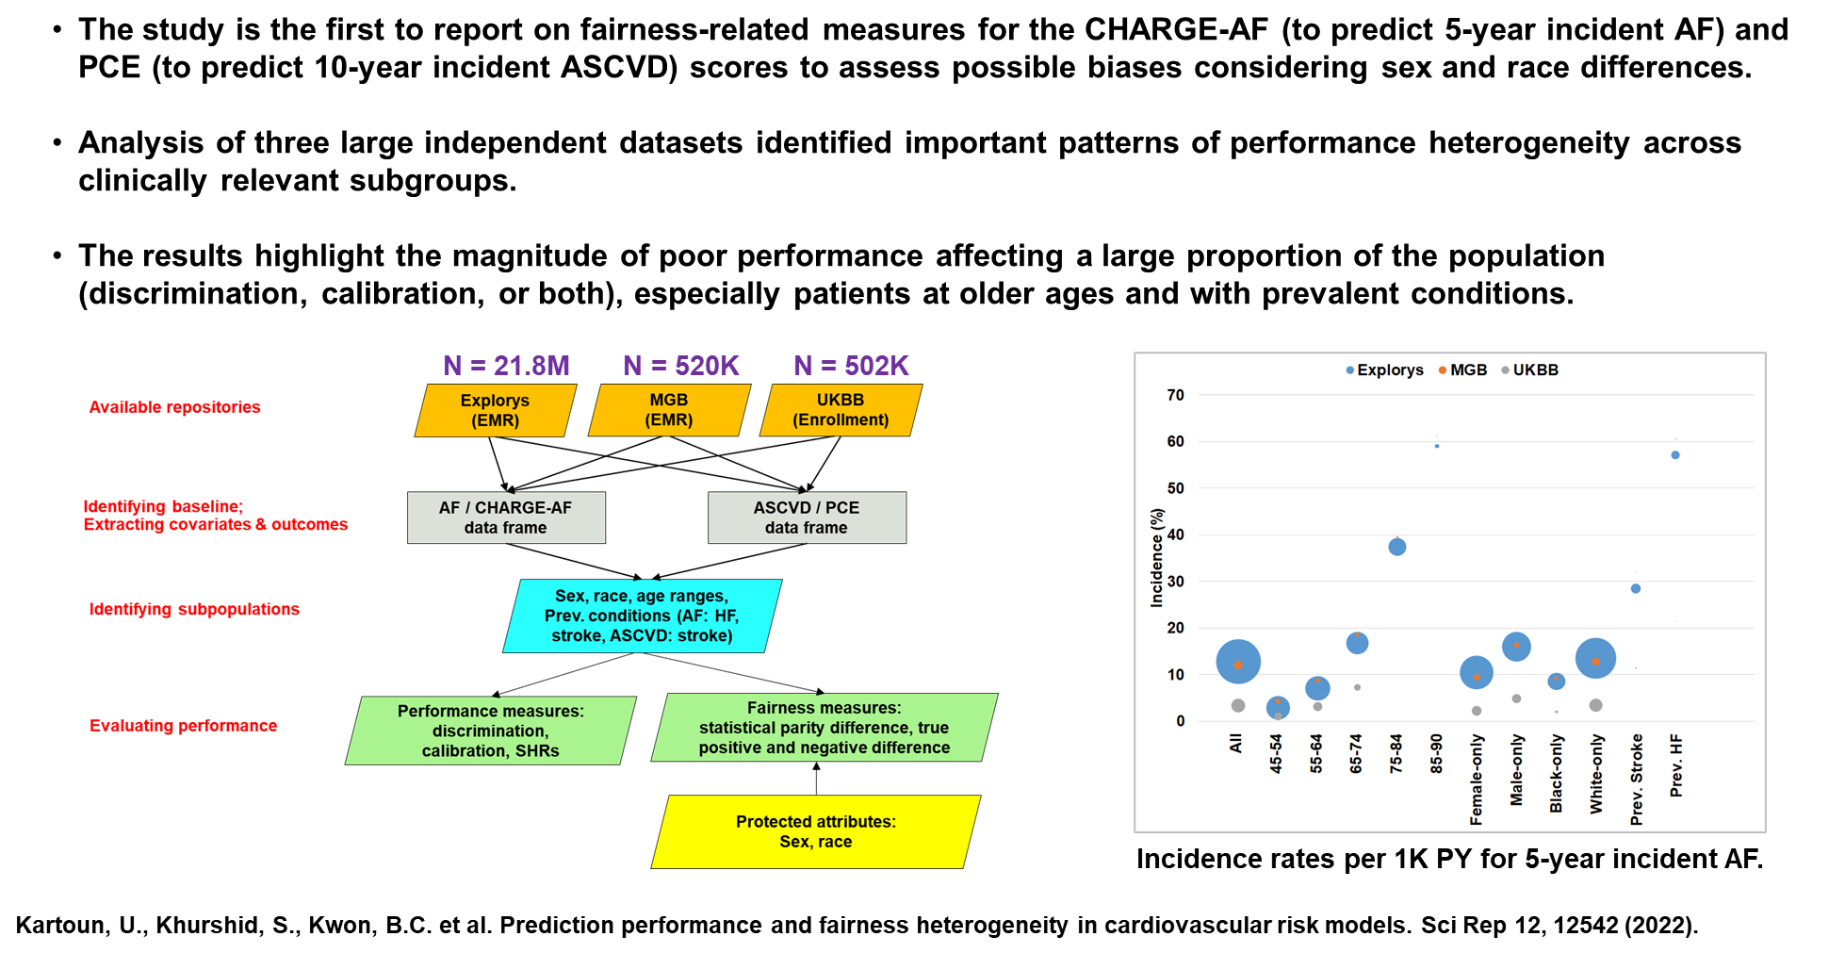
Heterogeneity in Cardiovascular Risk Prediction
Notes:
there is a need to develop better risk assessment tools as the existing ones do not work properly (such as the PCE and CHARGE-AF that we assessed); the paper demonstrates that quantitatively by evaluating these 2 widely used scores using 3 independents databases. The scores provide unfair assessments (men vs women, whites vs blacks, age differences)

Slide 36
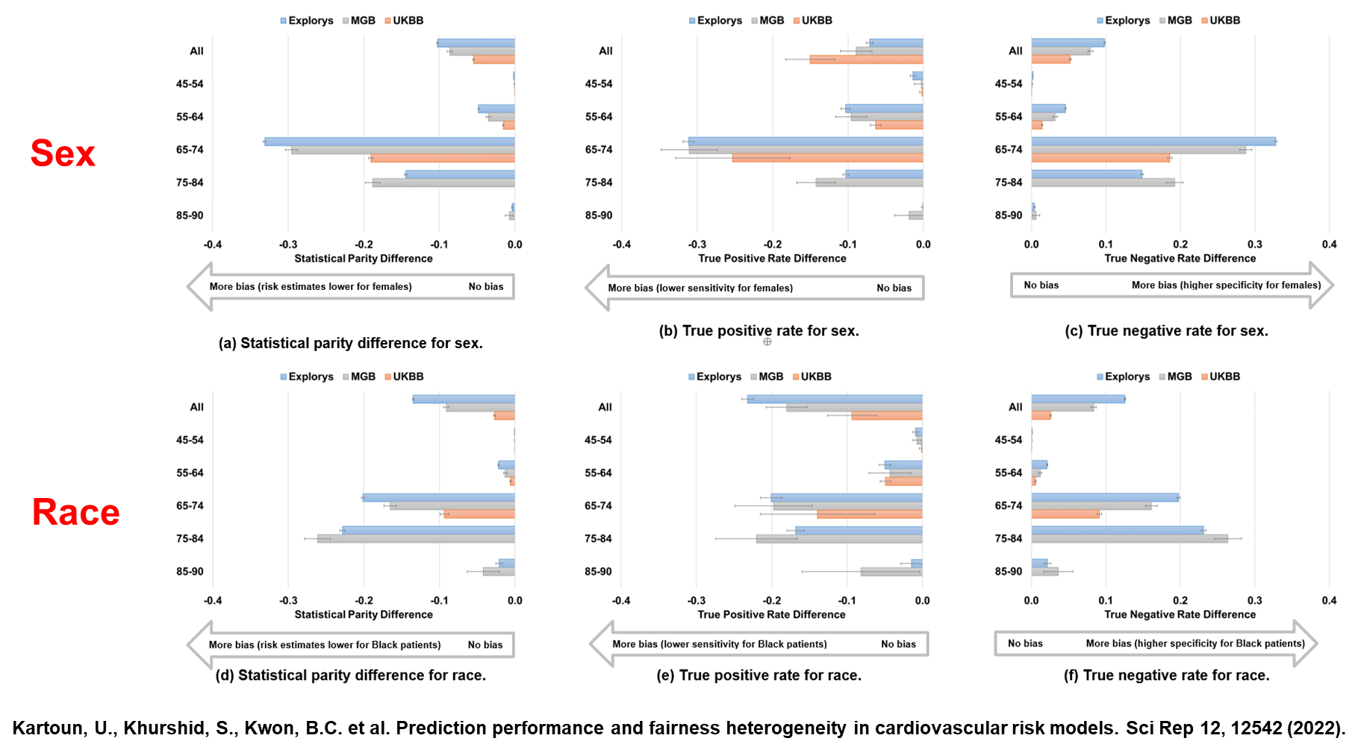
Heterogeneity in Fairness / CHARGE-AF
Notes:
For example, using CHARGE-AF, discrimination increased and then declined with increasing age.
Even though sex is not included in CHARGE-AF, the statistical parity difference (i.e., likelihood of being classified as high risk) was considerable between males and females within the 65-74 years subgroup.

Slide 37
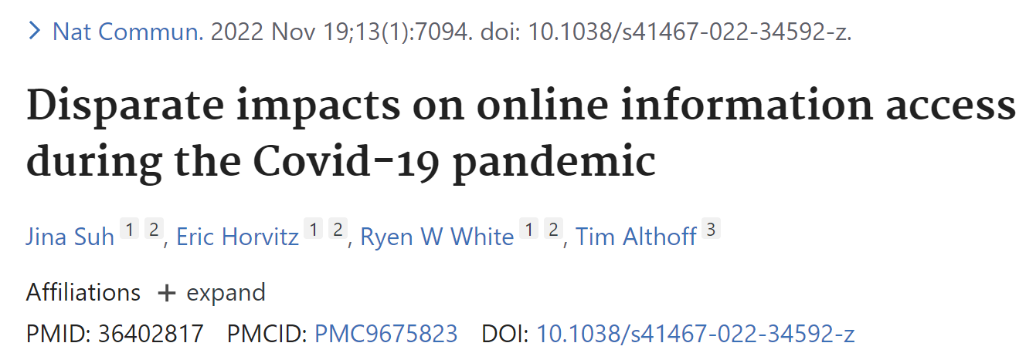
Ethical, Legal and Social Issues

Slide 38
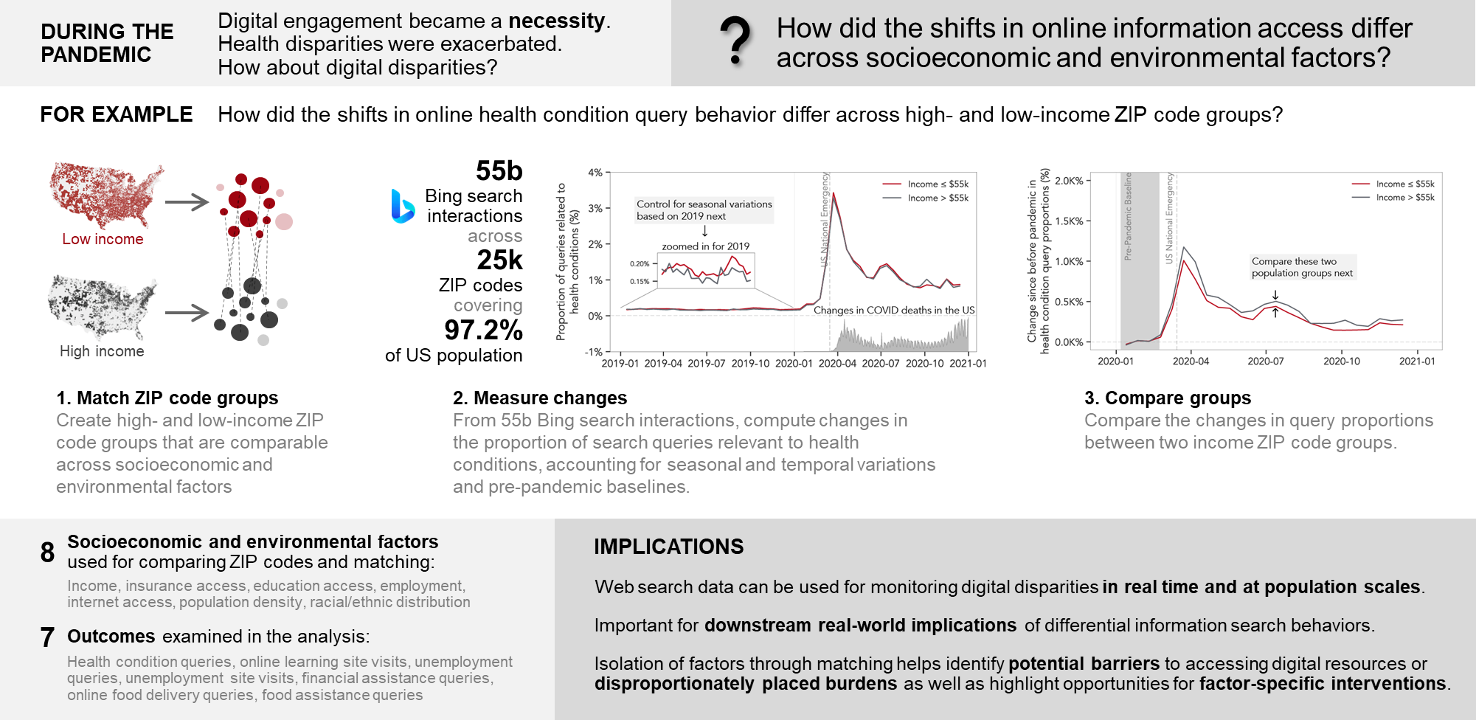
Disparate Impacts on Online Information Access during the COVID-19 Pandemic
Notes:
During the COVID-19 pandemic, digital engagement became a necessity because many resources for health, education and unemployment became available online due to lock down measures. While many researchers have noted the impact of the pandemic on health disparities, this study set out to study how digital disparities changed during the pandemic, specifically asking the question of “How did the shifts in online information access differ across socioeconomic and environmental factors?”
To illustrate the method of this study, let’s examine how they computed the differences in online health condition queries across high-income and low-income ZIP code groups.
First, they created high- and low-income ZIP code groups that are comparable – in other words, when all other meaningful socioeconomic and environment factors were similar except income.
Then, from 55 billion Bing search interactions across 25,000 US ZIP codes overing 97.2% of the total US population between 2019 and 2020, they computed the relative change in the proportion of search queries relevant to health conditions, while accounting for seasonal and temporal variations and pre-pandemic baselines.
Finally, they computed the changes in query proportions between these two comparable high- and low-income ZIP code groups.
Their full study incorporated 8 different socioeconomic and environment factors, inspired by the social determinants of health, across 8 outcomes spanning health, employment, finance, learning, and food.
This study highlights that web search data can be harnessed for real-time and population-scale monitoring of digital disparities, which is important for understanding downstream real-world implications of such differential digital engagement. Their technique of isolating factors through matching-based approach helps identify potential barriers to accessing digital resources or disproportionately placed burdens towards which factor-specific interventions could be targeted.

Slide 39
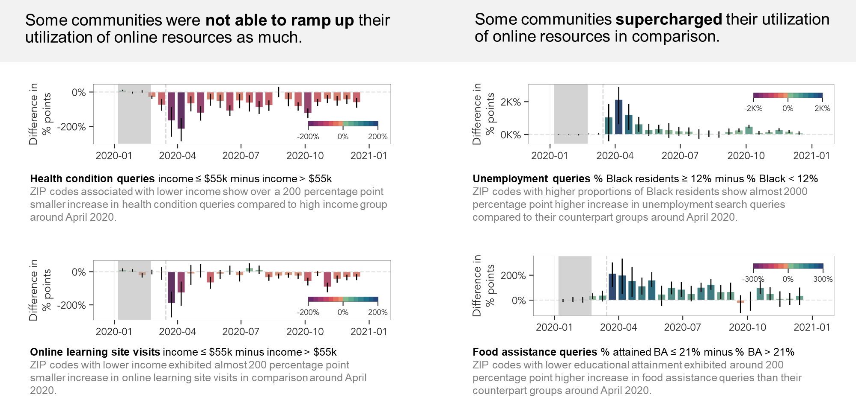
Disparate Impacts on Online Information Access during the COVID-19 Pandemic
Notes:
To highlight key findings from this study, they found that some communities were not able to ramp up their utilization of online resources as much as other communities.
For example, just after the pandemic was declared in the US, ZIP codes associated with lower income exhibited over a 200 percentage point smaller increase in health condition queries compared to high income group. Low-income ZIP code group also showed 200 percentage point smaller increase in online learning site visits compared to high-income group.
On the other hand, some communities supercharged their utilization of online resources in comparison, highlight extra burdens placed on those communities.
For example, ZIP codes with higher proportions of Black residents showed almost 2000 percentage point higher increase in unemployment search queries, and ZIP codes with lower educational attainment exhibited 200 percentage point higher increase in food assistance queries around the same time.
For more details about the study, please check out the DOI link provided in the slides.

Slide 40
Clinical Decision Support
Notes:
We have noticed an increasing trend of using machine learning for clinical decision support. Here, we will highlight four studies.

Slide 41
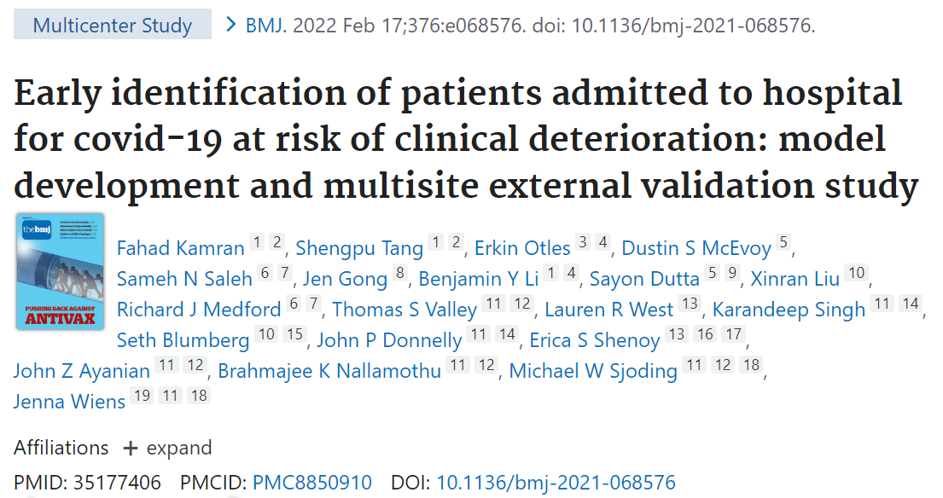
Clinical Decision Support
Notes:
One major concern of machine learning-based clinical decision support is its generalizability. This article titled “early identification of patients admitted to hospital for covid-19 at risk of clinical deterioration: model development and multisite external validation study” leveraging the ensemble techniques of linear models shows very good generalizability.

Slide 42
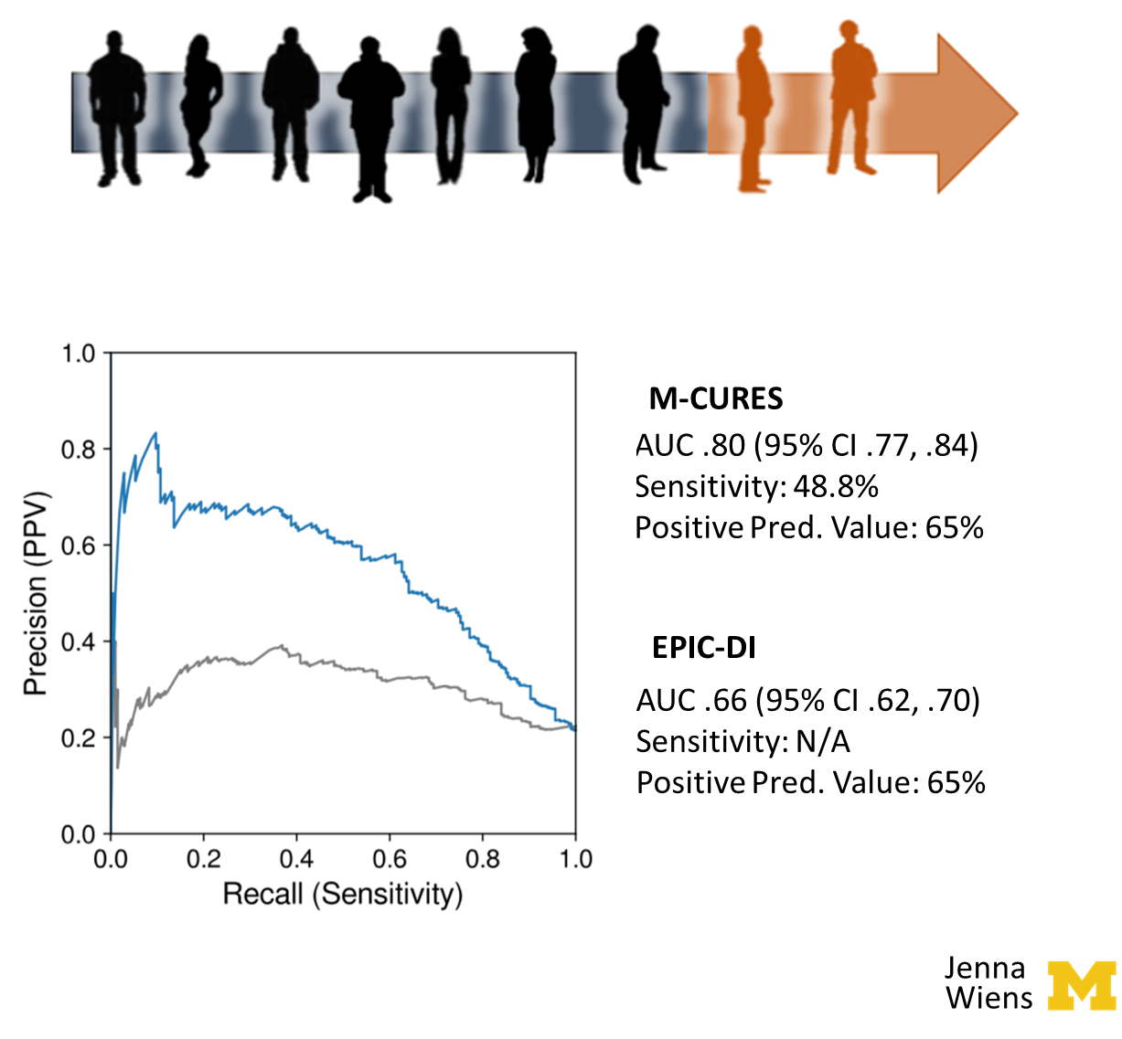
Triaging ‘high risk’
Can we identify patients with covid-19 at risk of clinical deterioration?
Task: Identify individuals who will experience an adverse outcome within the first 5 days of admission
Validation cohort: 956 (21.6%)
nine clinical and personal characteristic variables selected from 2686 variables
Notes:
Specifically, tools that could help identify patients at greatest risk of complications or adverse outcomes from the disease for example those who might need respiratory support, including a mechanical ventilator, cardiovascular support, and those who would likely die in hospital from the disease. Such a predictive model could help hospital manage a surge in COVID-19 patients and anticipate needs well in advance.
The authors took a data-centric approach to identify patients with risk of clinical deterioration leveraging electronic health record data. Using nine clinical and personal characteristic variables selected from 2686 variables, an accurate model of M-CURES was developed.
We evaluated the model’s predictions on a held-out test cohort of over 200 patients. In particular, advised with clinicians in the hospital we focused on two use cases. The first aims to identify individuals who will experience and adverse outcome early after admission. Nearly 30% of the test cohort met this outcome, and the M-CURES model achieved good discriminative performance correctly identifying over half of the high-risk cases with a positive predictive value of 70%, significantly outperforming a proprietary deteriorative index integrated in the EHR.
When the model was applied to the internal validation cohort, it achieved an AUROC of 0.80 (95% confidence interval 0.77 to 0.84) and an expected calibration error of 0.01 (95% confidence interval 0.00 to 0.02).
The EPIC DI scores is currently implemented across the US and is also designed to be automatically calculated in the background on an EHR systems. Though the index was developed prior to the pandemic, its availability has resulted in widespread use and validation effort for patients with COVID-19.

Slide 43
External Validation
validated on over 9,000 COVID-19 positive individuals at Michigan Medicine and 12 other external hospitals.
Notes:
Six sites with fewer than 100 patient admissions that met the primary outcome were combined into a single cohort when performance evaluations.
Performance was consistent when validated in the 12 external medical centers (AUROC range 0.77-0.84), across subgroups of sex, age, race, and ethnicity (AUROC range 0.78-0.84), and across quarters (AUROC range 0.73-0.83).

Slide 44
Building Risk Stratification Models that Generalize
Leverage data from related tasks when data are limited – trained on a related cohort of individuals presenting in the emergency department with shortness of breath
Clinician-in-the-loop validation – small number of COVID-19 cases on which to validate, scrutinize the model and ensure that it aligns with clinical intuition
Share code when you cannot share data – to assess generalizability worked with other hospital centers to share code and test model on different patient populations
Notes:
From a machine learning for healthcare perspective, this study tackled several challenges related to the development of risk stratification models.
First, at the beginning of the pandemic, there was relatively little training data from which to learn. The team leveraged data from a large retrospective cohort of individuals presenting in the emergency department with respiratory symptoms.
Secondly, due to the same reason, the authors engaged clinician in the loop to validate the model.
Lastly, the generalizability of the model was achieved by sharing codes with a small subset of variables that are readily available at other institutions that could easily transfer across institutions/populations.

Slide 45
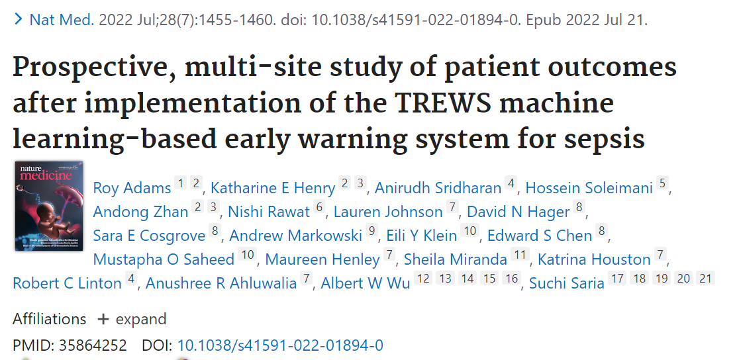
Clinical Decision Support
Notes:
How can we talk about machine learning for clinical decision support without the sepsis prediction use case?.
There are many sepsis prediction systems but few are deployed with outcome studies. We highlight this nature medicine article by Roy Adams et al which is a prospective, multi-site cohort study to examine the association between patient outcomes and provider interaction with a deployed sepsis alert system called the Targeted Real-time Early Warning System (TREWS). The study shows that early warning systems have the potential to identify sepsis patients early and improve patient outcomes and that sepsis patients who would benefit the most from early treatment can be identified and prioritized at the time of the alert.

Slide 46
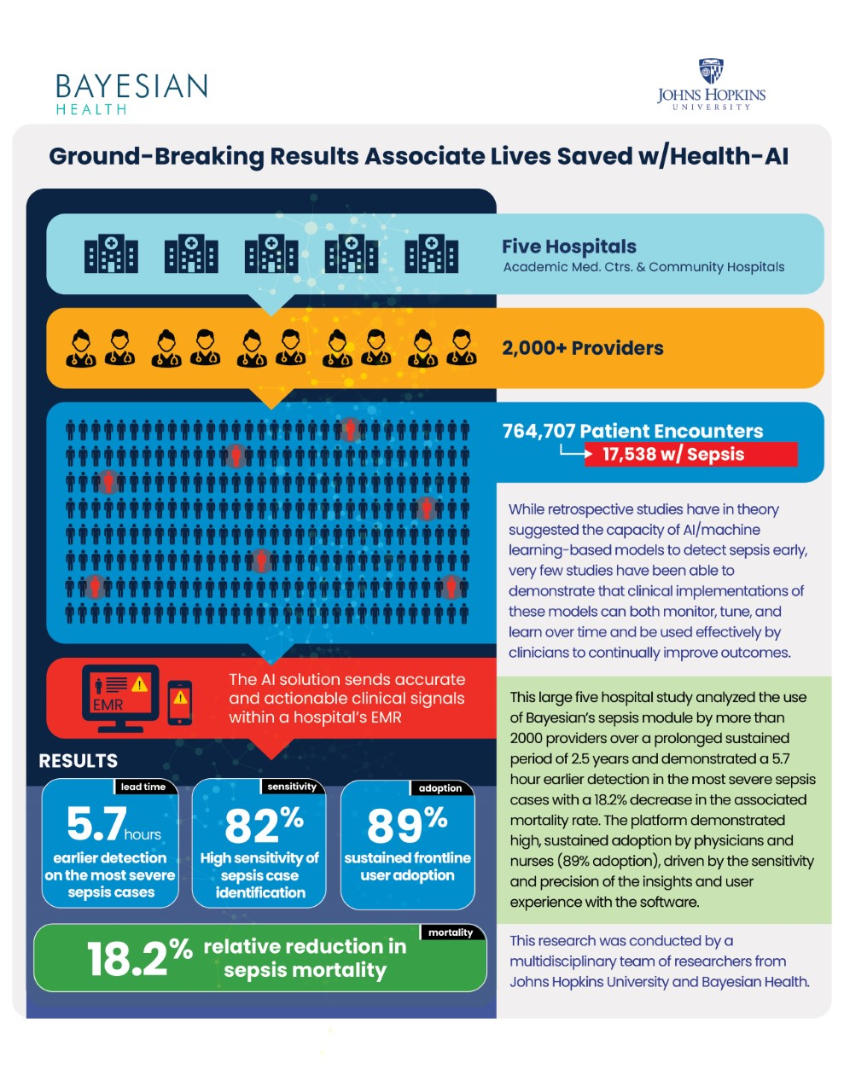
Targeted Real-time Early Warning System (TREWS)
Sepsis is one of the leading causes of in-hospital mortality and early identification and treatment key to successful outcomes.
The Targeted Real-time Early Warning System (TREWS) for sepsis uses machine learning to detect early sepsis symptoms
Delivers bedside alerts
Deployed enterprise-wide across five Johns Hopkins hospitals in partnership with Bayesian Health (a Health AI platform company)
Results reflect data from over 500k screened patients
Notes:
Specifically, results from the prospective evaluation of deployment of a machine learning–based early warning system for sepsis in five hospitals demonstrated the impact of their work on clinical outcomes: a reduced in-hospital mortality rate, organ failure and length of stay.

Slide 47
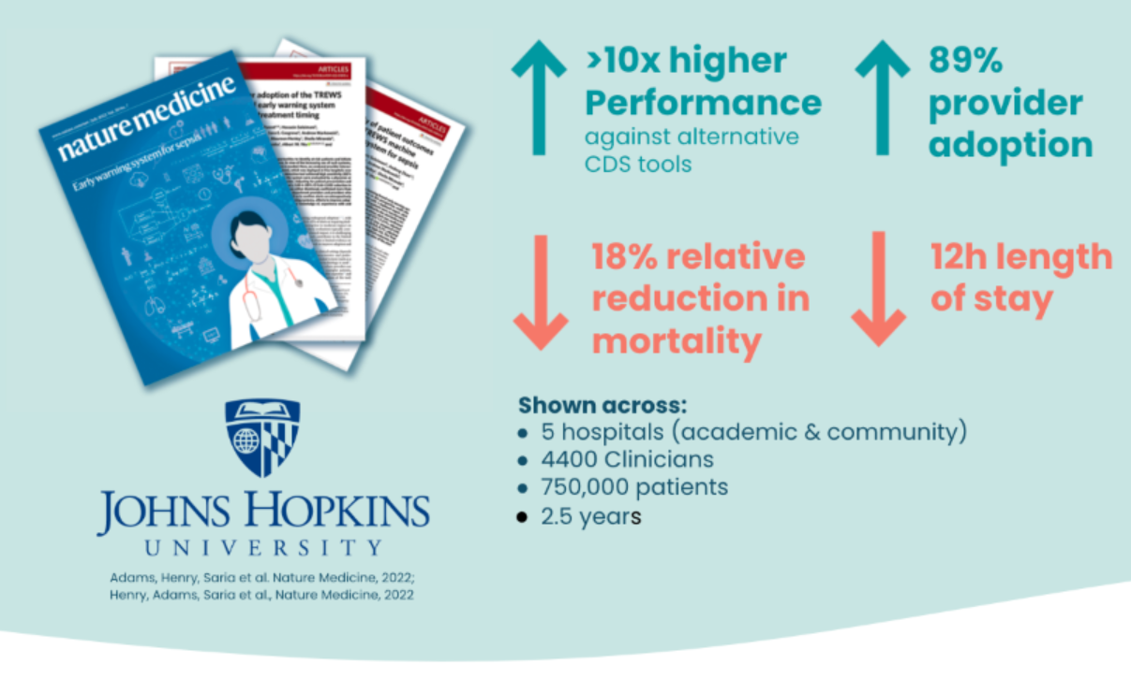
Patient outcomes
Confirmation of TREWS within 3 hours also associated with improvements in sepsis outcomes:
In-hospital mortality: 3.3% absolute and 18.2% relative reduction
Median length of stay: 11.5 hour reduction
Organ failure: 0.26 point reduction in average SOFA score
Associations larger among high-risk patients
In-hospital mortality: 4.5% absolute and 13% relative reduction
Median length of stay: 14.2 hour reduction
Organ failure: 0.38 point reduction in average SOFA score
Notes:
The prospective evaluation demonstrates the system works with significant reduction in-hospital mortality reduction, hospital stay, and organ failure.

Slide 48
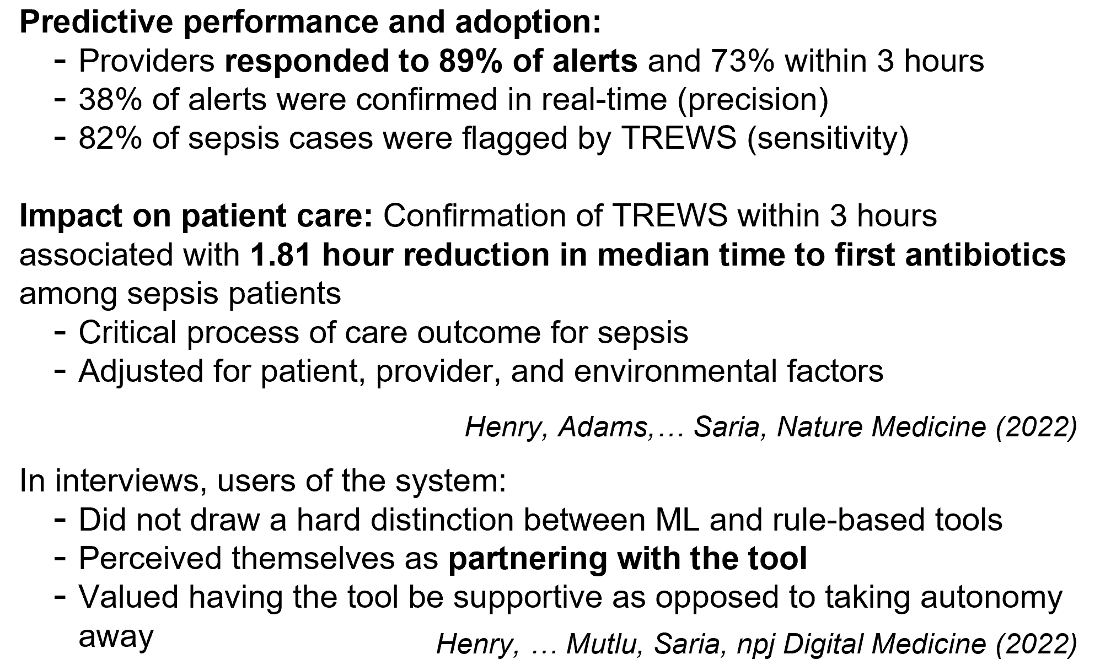
Provider adoption of TREWS
Notes:
Most of the work of its kind is evaluated on retrospective data at a single site, those evaluated on live data at multiple sites are very rare.
This work provides predictive performance and adoption, illustrate the impact on patient care, and in a separate companion paper, the authors also reported the acceptance of the tool to be supportive as opposed to taking autonomy away.

Slide 49
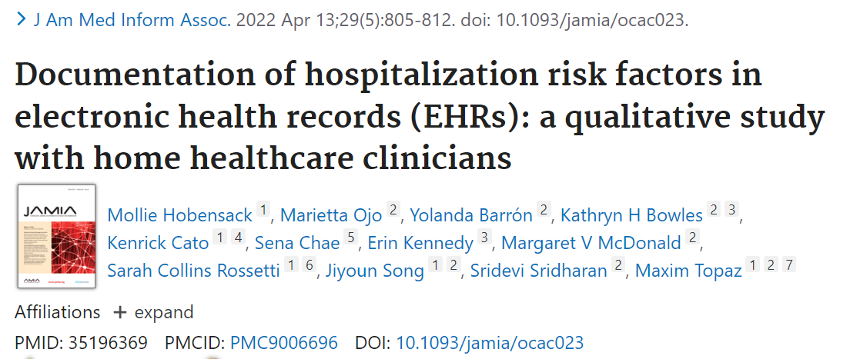
Clinical Decision Support
Notes:
Given the success of machine learning-based sepsis prediction, can we leverage machine learning to identify patients needing hospitalization.
This qualitative study reported the identification of the risk factors home healthcare (HHC) clinicians associate with patient deterioration and understand how clinicians respond to and document these risk factors.

Slide 50
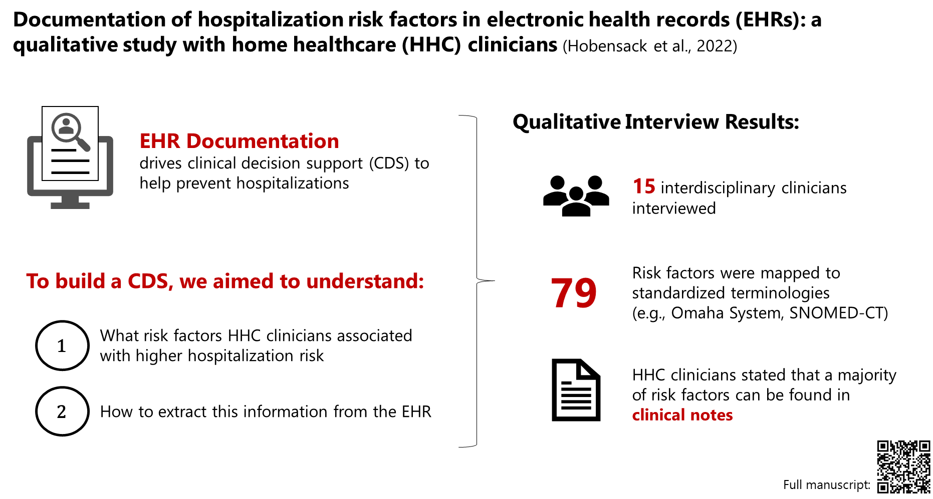
EHR Documentation for CDS
Notes:
Specifically, 1 in 5 patients are hospitalized; clinical decision support can help to reduce hospitalization, however, EHR documentation helps to drive CDS
Thus to build a CDS we sought to understand what 1)what risk factors Home Health Care clinicians associated with higher hospitalization risk and 2) where to extract this information in the HER
The authors conducted qualitative interviews from January – March 2021 via Zoom at one HHC agency in the US. We used snowball sampling. We analyzed our data using thematic analysis
Fifteen HHC clinicians identified a total of 79 risk factors that were mapped to standardized terminologies. HHC clinicians most frequently responded to risk factors by communicating with the prescribing provider (86.7% of clinicians) or following up with patients and caregivers (86.7%). HHC clinicians stated that a majority of risk factors can be found in clinical notes (ie, care coordination (53.3%) or visit (46.7%)).

Slide 51
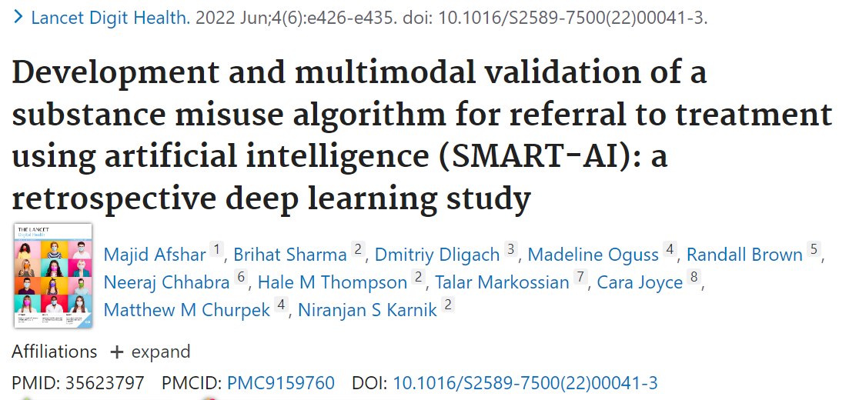
Clinical Decision Support
Notes:
All the previous articles are about traditional machine learning approaches for clinical decision support. This paper illustrates the use of deep learning for clinical decision support in referral to treatment for substance misuse.
We all know substance misuse is a heterogeneous and complex set of behavioral conditions that are highly prevalent in hospital settings and frequently co-occur. Few hospital-wide solutions exist to comprehensively and reliably identify these conditions to prioritize care and guide treatment.
The SMART-AI system leverages the first 24 h of EHR notes for screening multiple types of substance misuse.

Slide 52
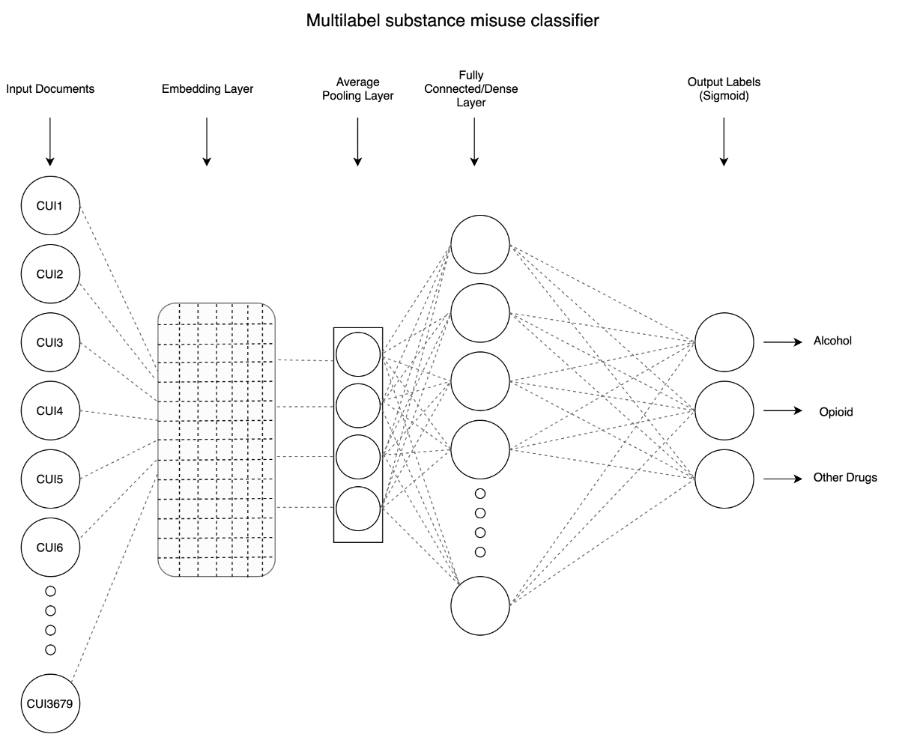

Deep Learning for Substance Use
SMART-AI
Best model was a Multilabel CNN using concept embeddings as features
Problem: No formal screening program at most hospitals despite recommendation from US Preventive Services Taskforce
Solution: Leveraging data collected during usual care clinical documentation for automated screening
Inclusion Cohort: All Hospitalized Adults
Training Data: 1st 24 hours of all notes and reports in the EHR
Training Labels: Manual screening with validated questionnaire on substance misuse (alcohol, opioid, and non-alcohol) in over 60,000 patients
Models Evaluated: Keyword rule-based, linear machine learning, non-linear deep learning
Validation: Internal temporal validation in prospective cohort; External validation at another health system
Trained Model at https://github.com/Rush-SubstanceUse-AILab/SMART-AI
Notes:
The model was trained and developed on a reference dataset derived from a hospital-wide program at Rush University Medical Center (RUMC) that used structured diagnostic interviews to manually screen admitted patients over 27 months (between Oct 1, 2017, and Dec 31, 2019; n=54 915).
The Alcohol Use Disorder Identification Test and Drug Abuse Screening Tool served as reference standards.
The first 24 h of notes in the EHR were mapped to standardized medical vocabulary and fed into single-label, multilabel, and multilabel with auxillary-task neural network models.
Temporal validation of the model was done using data from the subsequent 12 months on a subset of RUMC patients (n=16 917). External validation was done using data from Loyola University Medical Center, Chicago, IL, USA between Jan 1, 2007, and Sept 30, 2017 (n=1991 adult patients).
The primary outcome was discrimination for alcohol misuse, opioid misuse, or non-opioid drug misuse. Discrimination was assessed by the area under the receiver operating characteristic curve (AUROC). Calibration slope and intercept were measured with the unreliability index. Bias assessments were performed across demographic subgroups.
The best model was a multilabel CNN with concept embeddings as features.

Slide 53
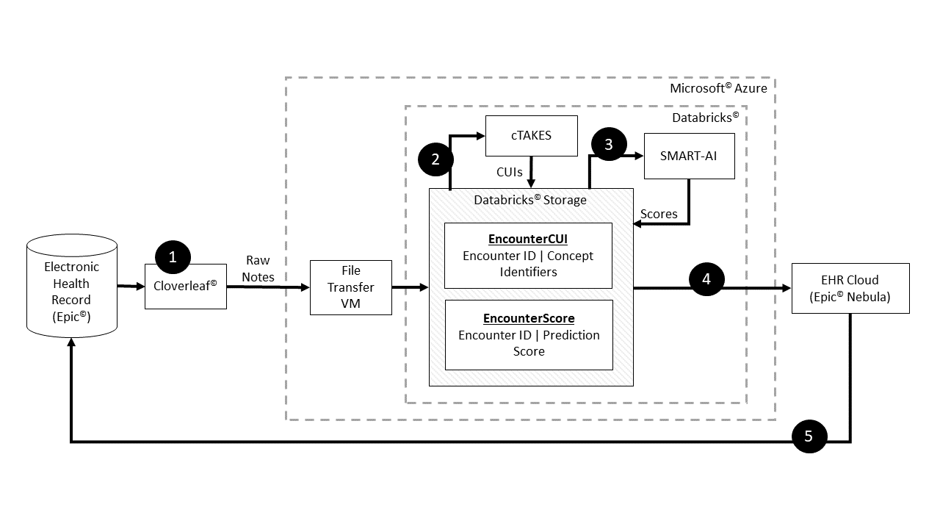
Results and Implementation for Clinical Study
Discrimination and Alarm Rate: i) Overall AUROC: 0.97 (95% CI: 0.96 - 0.98); ii) Overall AUPRC: 0.69 (95% CI: 0.64 - 0.74); iii) Number Needed to Evaluate: 1.5 for alcohol misuse, 1.3 for opioid misuse, 2.6 for non-opioid drug misuse; and iv) 39, 26, and 16 alerts per 1000 patients for each group
Calibration: Well calibrated with slope and intercept near 0 and 1
Bias and Fairness: i) False omission rate and the false-positive rate remained low at 3% or less across subgroups of age, sex, and race and ethnicity; ii) False-negative rates and false-positive rates were similar between non-Hispanic Black and non-Hispanic White groups.
Explainability/Face Validity: Top features were ethanol for alcohol misuse, heroin for opioid misuse, and cocaine for non-opioid drug misuse
ClinicalTrials.gov (active): NCT05745480
Pre-Post Outcomes Analysis with Cost-effectiveness
Non-inferiority design against usual care
Real-time NLP for SMART-AI in EHR with best practice alert to recommend Addiction Consult Services in Screen Positives
Notes:
The multilabel convolutional neural network classifier had a mean AUROC of 0·97 (95% CI 0·96–0·98) during temporal validation for all types of substance misuse. The model was well calibrated and showed good face validity with model features containing explicit mentions of aberrant drug-taking behaviour. A false-negative rate of 0·18–0·19 and a false-positive rate of 0·03 between non-Hispanic Black and non-Hispanic White groups occurred. In external validation, the AUROCs for alcohol and opioid misuse were 0·88 (95% CI 0·86–0·90) and 0·94 (0·92–0·95), respectively.

Slide 54
Consumer and Pervasive Health Informatics
Notes:
Along this topic,

Slide 55
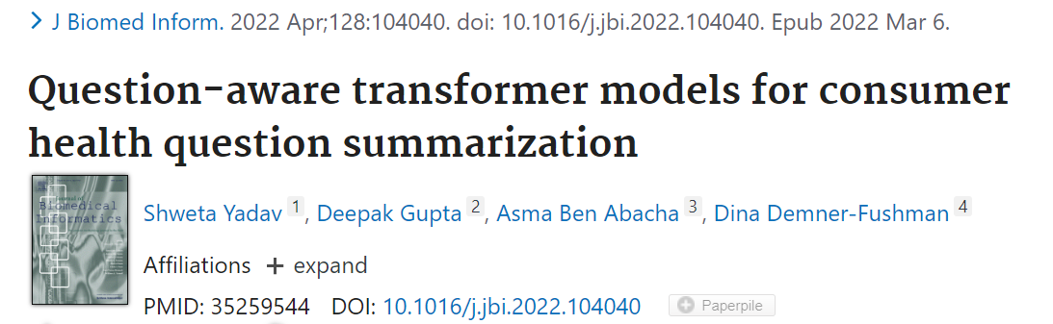
Consumer and Pervasive Health Informatics
Notes:
Searching for health information online is becoming customary for more and more consumers every day. An important contributor to the success rates of the Question-Answering systems is their ability to fully understand the consumers’ questions. However, these questions are frequently longer than needed and mention peripheral information that is not useful in finding relevant answers. Question summarization is one of the potential solutions to simplifying long and complex consumer questions before attempting to find an answer.
In this paper, the authors study the task of abstractive summarization for real-world consumer health questions. We develop an abstractive question summarization model that leverages the semantic interpretation of a question via recognition of medical entities, which enables generation of informative summaries. Towards this, we propose multiple Cloze tasks (i.e. the task of filing missing words in a given context) to identify the key medical entities that enforce the model to have better coverage in question-focus recognition. Additionally, we infuse the decoder inputs with question-type information to generate question-type driven summaries. When evaluated on the MeQSum benchmark corpus, our framework outperformed the state-of-the-art method by 10.2 ROUGE-L points. We also conducted a manual evaluation to assess the correctness of the generated summaries.

Slide 56
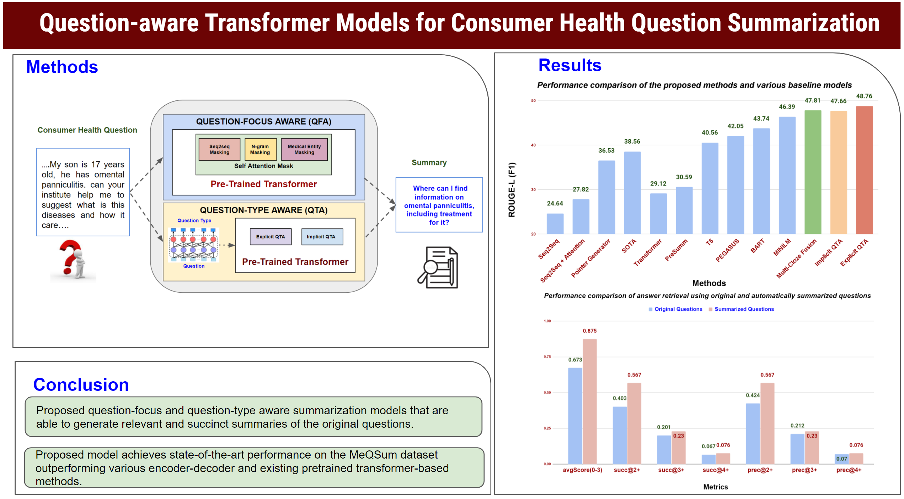
Notes:
The authors introduce explicit and implicit ways (e.g., use of Cloze tasks) of infusing the knowledge of the question type in pretrained transformer models for the generation of informative and question-type driven summaries. The author’s proposed model achieves state-of-the-art performance in the consumer health question summarization task and outperforms the recent state-of-the art pretrained LM models (e.g. T5, PEGASUS, and BART). The authors conduct an automatic evaluation on the MeQSum benchmark and a manual evaluation to assess the correctness of the generated question summaries (from study Highlights)

Slide 57
Contributions
MeQSum benchmark of 1,000 consumer health questions and their associated summaries.
Introduce various Cloze tasks to pretrained transformer models for better coverage of the question focus
Introduce explicit and implicit ways of infusing the knowledge of the question type
Explicit: adding the predicted question type
Implicit: a multi-task learning approach (the model learns to predict the question type and the primary task of question summarization)
The proposed model outperforms T5, PEGASUS, and BART
Notes:
This study is significant as it proposes a potential solution for simplifying complex health questions before answering them, which could improve the success rates of question answering systems for health information online. The study's model uses a novel technique to generate informative summaries and performs better than existing methods, demonstrating its potential for improving the quality of question-answering system output.

Slide 58
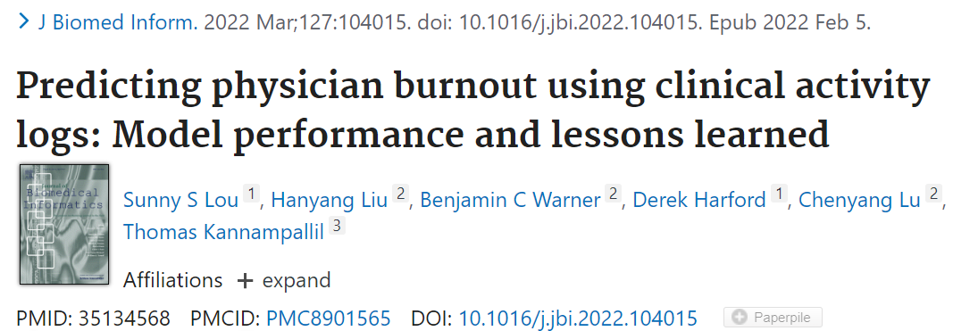
Consumer and Pervasive Health Informatics
Notes:
Burnout is a significant public health concern affecting more than half of the healthcare workforce; however, passive screening tools to detect burnout are lacking. This paper investigated the ability of machine learning (ML) techniques to identify burnout using passively collected electronic health record (EHR)-based audit log data. This study is interesting as findings indicate that model performance is no better than base line burnout prediction.
Current findings illustrate the complexities of predicting burnout exclusively based on clinical work activities as captured in the EHR, highlighting its multi-factorial and individualized nature. Future prediction studies of burnout should account for individual factors (e.g., resilience, physiological measurements such as sleep) and associated system-level factors (e.g., leadership).

Slide 59
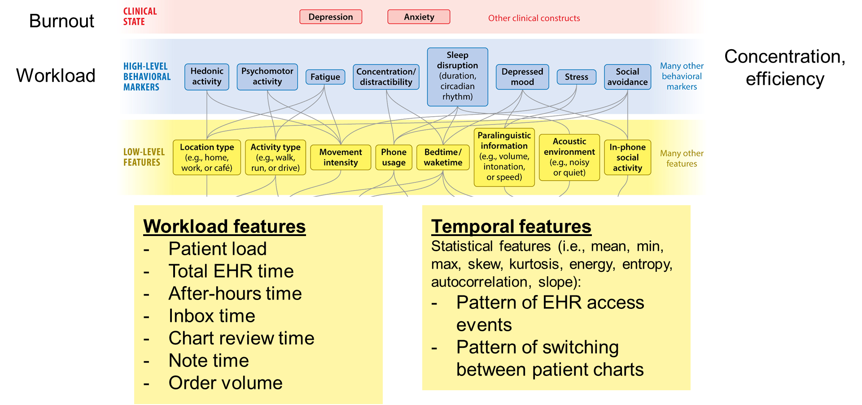
Notes:
Physician trainees participated in a longitudinal study where they completed monthly burnout surveys and provided access to their EHR-based audit logs. Using the monthly burnout scores as the target outcome, we trained ML models using combinations of features derived from audit log data—aggregate measures of clinical workload, time series-based temporal measures of EHR use, and the baseline burnout score. Five ML models were constructed to predict burnout as a continuous score: penalized linear regression, support vector machine, neural network, random forest, and gradient boosting machine.

Slide 60
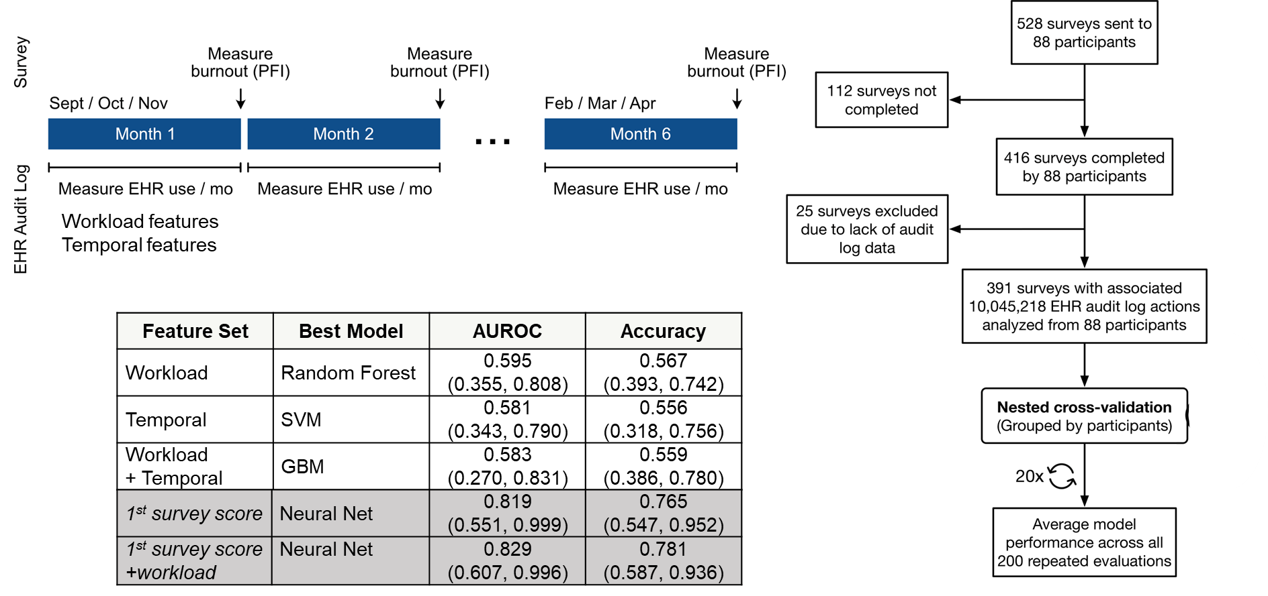
Address a significant public health concern
Develop machine learning-based digital phenotype of burnout using audit log files.
Machine learning models relying on EHR-based workload metrics had limited discriminative performance, highlighting the multi-factorial and highly-individualized nature of physician burnout
Notes:
M88 trainee physicians participated and completed 416 surveys; greater than10 million audit log actions were collected (Mean [Standard Deviation] = 25,691 [14,331] actions per month, per physician). The workload feature set predicted burnout score with a mean absolute error (MAE) of 0.602 (95% Confidence Interval (CI), 0.412–0.826), and was able to predict burnout status with an average AUROC of 0.595 (95% CI 0.355–0.808) and average accuracy 0.567 (95% CI 0.393–0.742). The temporal feature set had a similar performance, with MAE 0.596 (95% CI 0.391–0.826), and AUROC 0.581 (95% CI 0.343–0.790). The addition of the baseline burnout score to the workload features improved the model performance to a mean AUROC of 0.829 (95% CI 0.607–0.996) and mean accuracy of 0.781 (95% CI 0.587–0.936); however, this performance was not meaningfully different than using the baseline burnout score alone.

Slide 61
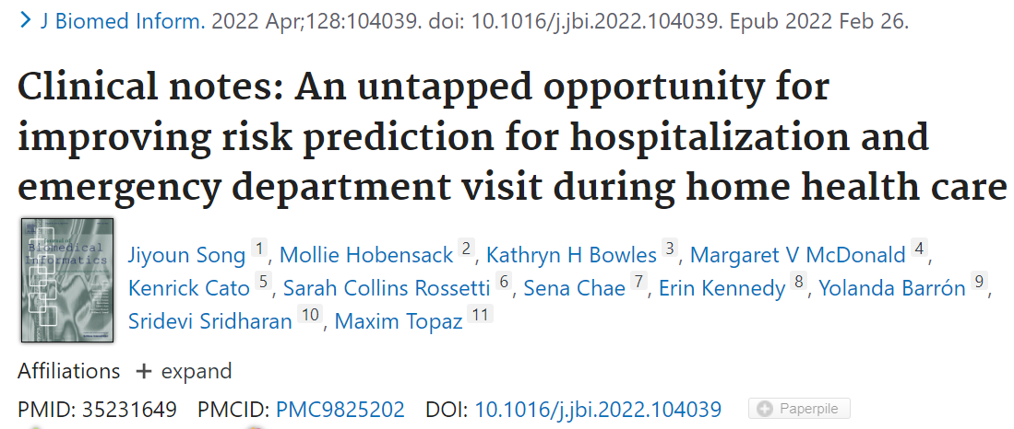
Consumer and Pervasive Health Informatics - 3
Notes:
Between 10 and 25% patients are hospitalized or visit emergency department (ED) during home healthcare (HHC). Given that up to 40% of these negative clinical outcomes are preventable, early and accurate prediction of hospitalization risk can be one strategy to prevent them. In recent years, machine learning-based predictive modeling has become widely used for building risk models. This study aimed to compare the predictive performance of four risk models built with various data sources for hospitalization and ED visits in HHC.

Slide 62
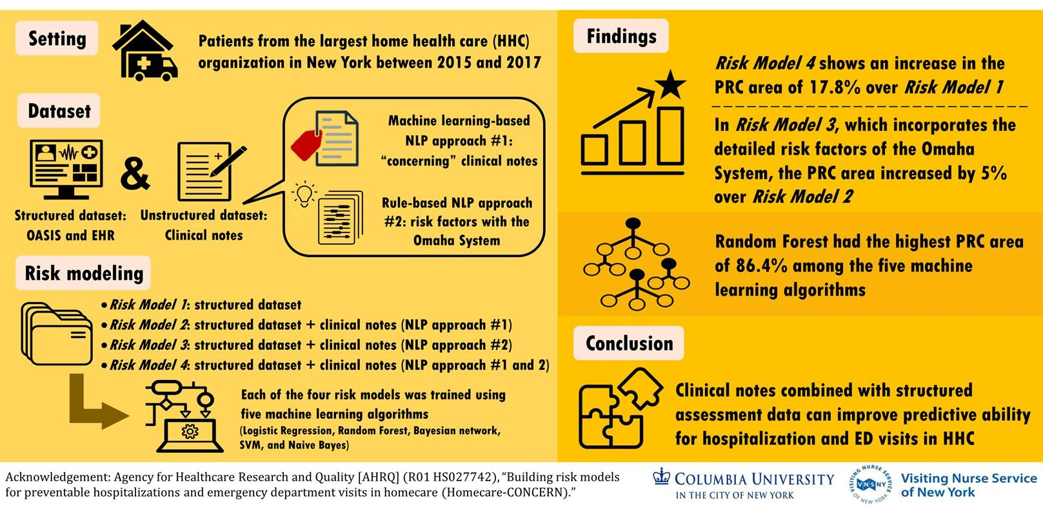
Release the hidden power of clinical notes
Notes:
The study aimed to compare the predictive performance of four risk models built with different data sources for hospitalization and emergency department (ED) visits in home healthcare (HHC). The study used structured data and unstructured narrative-free text clinical notes for patients who received HHC services from a non-profit organization in New York between 2015 and 2017.
Four risk models were built using different variables from two data sources: structured data (i.e., Outcome and Assessment Information Set (OASIS) and other assessment items from the electronic health record (EHR)) and unstructured narrative-free text clinical notes for patients who received HHC services from the largest non-profit HHC organization in New York between 2015 and 2017. Then, five machine learning algorithms (logistic regression, Random Forest, Bayesian network, support vector machine (SVM), and Naïve Bayes) were used on each risk model. Risk model performance was evaluated using the F-score and Precision-Recall Curve (PRC) area metrics.

Slide 63

The power demonstration
Result
During the study period, 8373/86,823 (9.6%) HHC episodes resulted in hospitalization or ED visits.
The SVM showed the highest F-score (0.82), while the Random Forest showed the highest PRC area (0.864).
Adding information extracted from clinical notes significantly improved the risk prediction ability by up to 16.6% in F-score and 17.8% in PRC.
Conclusion
Information from clinical notes integrated with the structured data improved the ability to identify patients at risk for these emergent care events.
Notes:
This study is significant because it shows that machine learning-based predictive modeling can be used to accurately predict emergent hospitalization or ED visits in the setting of home health care. The addition of clinical notes as a data source significantly improved the ability to identify patients at risk for these emergent care events, which can ultimately prevent negative clinical outcomes and improve patient care.
During the study period, 8373/86,823 (9.6%) HHC episodes resulted in hospitalization or ED visits. Among five machine learning algorithms on each model, the SVM showed the highest F-score (0.82), while the Random Forest showed the highest PRC area (0.864). Adding information extracted from clinical notes significantly improved the risk prediction ability by up to 16.6% in F-score and 17.8% in PRC.
All models showed relatively good hospitalization for ED visit risk predictive performance in HHC. Information from clinical notes integrated with the structured data improved the ability to identify patients at risk for these emergent care events.

Slide 64
Nursing Informatics

Slide 65

Nursing Informatics
Kennedy E.E, Davoudi A, Hwang S, Freda P.J, Urbanowicz R, Bowles K.H, Mowery D.L. Identifying Barriers to Post-Acute Care Referral and Characterizing Negative Patient Preferences Among Hospitalized Older Adults Using Natural Language Processing. AMIA 2022
Notes:
Post-acute care refusal is signficantly associated with worse patient outcomes and increased readmissions. This study is the first that used natural language processing to explore reasons for post-acute care refusal despite it being recommended to patients. This study could lead to other informatics related studies focused on improving post-acute care reception and patient outcomes. I found this study to be significant given how huge a problem post-acute care refusal could be for nursing care.

Slide 66

Process Workflow for Study Methods
Kennedy E.E, Davoudi A, Hwang S, Freda P.J, Urbanowicz R, Bowles K.H, Mowery D.L. Identifying Barriers to Post-Acute Care Referral and Characterizing Negative Patient Preferences Among Hospitalized Older Adults Using Natural Language Processing. AMIA 2022
Notes:
1. Used natural language processing to screen narrative notes and explore why patients refuse post-acute care despite it being recommended to them.

Slide 67

Supervised Learning Pipeline Using AutoML-BC
Notes:
2. Found that most common reasons include negative patient preference and having a caregiver. Insurance barriers is also highly correlated to not receiving much needed post-acute care.
2. Future studies could use these findings develop and test interventions to improve patient reception of post-acute care. This will then improve patient outcomes.

Slide 68

Nursing Informatics

Slide 69

Nurse documentation of patient problem discussions and nursing interventions in the EHR
To assess what health problems or nursing interventions were discussed during home health care (HHC) visits
To examine the information overlap between patient-nurse verbal communication and EHR documentation (i.e., clinical notes and structured data)
Song J, Zolnoori M, Scharp D, et al. Do nurses document all discussions of patient problems and nursing interventions in the electronic health record? A pilot study in home healthcare. JAMIA Open. 2022;5(2)
Notes:
Patients of the largest non-profit HHC organization in the Northeast between 2/16/2021 and 9/2/2021
Dataset #1. Nurse-Patient Verbal Communication
To generate a purposeful sample of informative recordings with information richness and recording quality, we selected 22 recordings representing 15 patients. Then, manual transcripts was created.
Dataset #2. EHRs
All information documented in the EHR during the selected audio-recorded HHC visits was retrieved and reviewed
The Outcome and Assessment Information Set (OASIS)
Visit-level structured assessment and nursing interventions data
Narrative clinical notes: 130 clinical notes (for 15 patients)
Identifying Health Problems and Nursing Interventions
Manual annotation on the transcribed verbal communication and documentation in EHR (i.e., structured data and clinical notes) for the presence of health problems and nursing interventions using the Omaha System terminology  comprehensive and standardized nursing taxonomy used in community-based care  as tags
Comprised of

Slide 70


Nurse documentation of patient problem discussions and nursing interventions in the EHR
Example #1. Identify problem through verbal communication was accordingly documented in the narrative notes and/or structured data
Example #2. Identify problem through verbal communication was completely missed in both narrative notes and structured data

Slide 71

Nurse documentation of patient problem discussions and nursing interventions in the EHR

Slide 72
Imaging Informatics

Slide 73


AI Enables Precision Disease Detection at Scale
Precision Identification of Hypertrophy
AI Texture Based Evaluation for Cardiac Amyloidosis
Duffy*, Cheng*, Yuan* et al. JAMA Cardiology. (Feb 23, 2022)
Notes:
Can deep learning be used to automate measurements of left ventricular dimensions and identify patients who could benefit from screening for underdiagnosed diseases?

Slide 74


AI Precision Assessment of Hypertrophy
https://arxiv.org/abs/2106.12511
Duffy*, Cheng*, Yuan* et al. JAMA Cardiology. (Feb 23, 2022)
Notes:
Beat-to-Beat Evaluation of Ventricular Dimensions
Model prediction of key points on an individual frame of parasternal long-axis video

Slide 75

Augmenting Clinical Intuition
Notes:
In this cohort study of 23 745 patients that used a deep learning algorithm to automatically measure left ventricular dimensions and to identify patients with increased wall thickness who may benefit from additional screening for hypertrophic cardiomyopathy and cardiac amyloidosis, the algorithm performed consistently across multiple cohorts while also delivering results in a shorter time than required for human assessment.
[The main outcome was the accuracy of the deep learning algorithm in measuring left ventricular dimensions and identifying patients with increased LV wall thickness diagnosed with hypertrophic cardiomyopathy and cardiac amyloidosis.]

Slide 76

Imaging Informatics

Slide 77

Cardiac Rejection Assessment Neural Estimator (CRANE)
Notes:
Endomyocardial biopsy (EMB) screening represents the standard of care for detecting allograft rejections after heart transplant. Manual interpretation of EMBs is affected by substantial interobserver and intraobserver variability, which often leads to inappropriate treatment with immunosuppressive drugs, unnecessary follow-up biopsies and poor transplant outcomes. Here the authors present a deep learning model for automated assessment of gigapixel whole-slide images obtained from EMBs, which simultaneously addresses detection, subtyping and grading of allograft rejection.

Slide 78

Performance of the CRANE model at patient level
Notes:
The model detects allograft rejection with an (AUC) of 0.962; assesses the cellular and antibody-mediated rejection type with AUCs of 0.958 and 0.874, respectively; detects Quilty B lesions, benign mimics of rejection, with an AUC of 0.939; and differentiates between low-grade and high-grade rejections with an AUC of 0.833.
United States, as well as independent test cohorts from Turkey and Switzerland, which includes large-scale variability across populations, sample preparations and slide scanning instrumentation

Slide 79

Visualization of the attention heatmaps for the US cohort
Notes:
A sample of WSIs of EMBs with different diagnoses are shown in the first column. The second column displays a magnified view of the cardiac tissue samples indicated by the blue arrows in the first column. An attention heatmap corresponding to each slide was generated by computing the attention scores for each predicted diagnosis (third column). The fourth column shows a magnified view of the ROIs indicated by the green squares in the second column, and the corresponding attention heatmaps are displayed in the fifth column. The last two columns show a magnified view of the ROIs indicated by the blue squares together with the corresponding attention heatmap. Green arrows indicate specific morphology corresponding to the textual description. The colormap of the attention heatmaps ranges from red (high attention) to blue (low attention). a, Cellular rejection. The highest attention scores correspond to regions with increased interstitial lymphocytic infiltrates and associated myocyte injury, whereas the adjacent, lower attention scores indicate healthier myocytes without injury. b, Antibody-mediated rejection. The highest attention scores correspond to regions with edema within the interstitial spaces in addition to increased mixed inflammatory infiltrate, comprised of eosinophils, neutrophils and lymphocytes. The adjacent lower attention scores indicate background fibrosis, stroma and healthier myocytes. c, Quilty B lesion. The highest attention scores identify a single, benign lymphocytic focus within the endocardium, without injury or damage to the myocardium. The lower attention scores indicate background and healthy myocytes. d, Cellular grade. The highest attention scores indicate diffuse, prominent interstitial lymphocytic infiltrates with associated myocyte injury, representing severe rejection. The lower attention regions indicate background fibrosis and unaffected, healthier myocytes.

Slide 80

Imaging Informatics

Slide 81

Radiopathomics model to predict pathological complete response to neoadjuvant chemoradiotherapy
Notes:
Accurate prediction of tumour response to neoadjuvant chemoradiotherapy enables personalised perioperative therapy for locally advanced rectal cancer. The authors aimed to develop and validate an ML model to integrate radiopathomics and to predict pathological complete response in patients with locally advanced rectal cancer using pretreatment MRI and (H&E)-stained biopsy slides.
[Images of pretreatment MRI images and biopsy haematoxylin and eosin-stained slides were retrospectively retrieved and segmented for feature extraction. After feature evaluation and modelling, three sets of signatures (rMRI, pNUC, and the pMENV) were generated and further used to construct the RAPIDS. The performance of RAPIDS in predicting pathological response (ie, pCR vs non-pCR) before administration of neoadjuvant chemotherapy was validated in two external retrospective cohorts and a multicentre, prospective observational clinical trial (NCT04271657). CE-T1WI=contrast-enhanced T1 weighted imaging. DWI=diffusion-weighted imaging. nCRT=neoadjuvant chemoradiotherapy. pCR=pathological complete response. pMENV=pathomics microenvironment. pNUC=pathomics tumour nucleus. RAPIDS=RAdioPathomics Integrated preDiction System. RFE=recursive feature elimination. rMRI=radiomics MRI. ROC=receiver operating characteristic. ROI=region of interest. SVM=support vector machines. T2WI=T2 weighed imaging.]

Slide 82

Retrospective training and validation cohorts
Notes:
The accuracy of RAPIDS for the prediction of pathological complete response in locally advanced rectal cancer was verified in two retrospective external validation cohorts and further validated in a multicentre, prospective observational study
Prediction performance of RAPIDS versus single-modality prediction models in the retrospective training and validation cohorts
Receiver operating characteristic curves of predictive performance for pathological complete response in patients with locally advanced rectal cancer among the three single-modality prediction models (rMRI, pathomics nucleus, and pathomics microenvironment) and RAPIDS in the training cohort (A), validation cohort 1 (B), and validation cohort 2 (C). AUC=area under curve. RAPIDS=RAdioPathomics Integrated preDiction System. rMRI=radiomics MRI.

Slide 83

Prospective observational study
Notes:
Prediction performance of RAPIDS versus single-modality and dual-modality prediction models in the prospective observational study
(A) RAPIDS versus single-modality prediction models (rMRI, pathomics nucleus, and pathomics microenvironment). (B) RAPIDS versus dual-modality prediction models (rMpN, rMpM, and pMpN). AUC=area under curve. pMpN=pathomics microenvironment and pathomics nucleus. RAPIDs=RAdioPathomics Integrated preDiction System. rMRI=radiomics MRI. rMpM=radiomics MRI and pathomics microenvironment. rMpN=radiomics MRI and pathomics nucleus.

Slide 84
Natural Language Processing
Notes:
If you are regular AMIA attendees, you may notice that natural language processing has always been part of everything – no matter it is about data quality, or clinical decision support, or consumer health. We have been leveraging statistics to model natural language. Right now, giving chatGPT becomes a term even my 7 year old talks about it, NLP is in an exciting and transformative era.

Slide 85

Natural Language Processing
Notes:
The first article we would like to highlight is this article by Yang et al.
It is not clear how large clinical language models with billions of parameters can help medical AI systems utilize unstructured EHRs.
The authors trained from scratch a large clinical language model-GatorTron-using >90 billion words of text (including >82 billion words of de-identified clinical text) and systematically evaluate it on five clinical NLP tasks including clinical concept extraction, medical relation extraction, semantic textual similarity, natural language inference (NLI), and medical question answering (MQA).

Slide 86
Notes:
The authors examine how (1) scaling up the number of parameters and (2) scaling up the size of the training data could benefit these NLP tasks.
GatorTron models scale up the clinical language model from 110 million to 8.9 billion parameters and improve five clinical NLP tasks (e.g., 9.6% and 9.5% improvement in accuracy for NLI and MQA), which can be applied to medical AI systems to improve healthcare delivery. The GatorTron models are publicly available at: https://catalog.ngc.nvidia.com/orgs/nvidia/teams/clara/models/gatortron_og .

Slide 87

Training and validation loss (GatroTron(s))
Training GatorTron-large model required ~6 days on 992 GPUs (A100 80Gb) from 124 NVIDIA SuperPOD nodes reference cluster architecture. !!!!!
The GatorTron-base model converged in 10 epochs, whereas the medium and large models converged in 7 epochs, faster convergence for larger models
Early stop
No further
improvement

Slide 88

GATORTRON VS OTHERS (METRICS)
GatorTron models outperformed existing biomedical and clinical transformer models performance

Slide 89

Useful?
Findings
Bigger is better - Scale up the size of training data and model size improved performance.
One model architecture solves 5 different clinical NLP tasks with state-of-the-art performance.
Larger language models help more in complex NLP tasks such as question answering.
Challenges
Security and privacy of PHI data
High-performance computing support
Potentials to healthcare
Patient information extraction
Assist in documenting patient reports, and reduce documentation burden
Assist in generating treatment plans.
Next-generation intelligent EHR systems with conversational ability.

Slide 90

Natural Language Processing
Notes:
The second article is about the development of domain-specific language models.
This study developed and evaluated cancer domain pretrained CancerBERT models for extracting breast cancer phenotypes from clinical texts. The authors also investigated the effect of customized cancer-related vocabulary on the performance of CancerBERT models.
The CancerBERT models were developed to extract the cancer phenotypes in clinical notes and pathology reports. The results validated that using customized vocabulary may further improve the performances of domain specific BERT models in clinical NLP tasks. The CancerBERT models developed in the study would further help clinical decision support.

Slide 91

Notes:
Specifically, a cancer-related corpus of breast cancer patients was extracted from the electronic health records of a local hospital. We annotated named entities in 200 pathology reports and 50 clinical notes for 8 cancer phenotypes for fine-tuning and evaluation. We kept pretraining the BlueBERT model on the cancer corpus with expanded vocabularies (using both term frequency-based and manually reviewed methods) to obtain CancerBERT models.
The CancerBERT models were evaluated and compared with other baseline models on the cancer phenotype extraction task.
CancerBERT fine-tuning model shows superior performances compared to the baseline models
Excellent performances for the complex name entities
E.g. Tumor size, Tumor site, Cancer stage and Histological type
Using customized vocabulary during pre-training and fine tuning further improve the model performance

Slide 92

Results-Model performance
Note: The scores were averaged scores based on 10 runs, * indicates statistically higher than other methods (CI: 0.95).
Notes:
All CancerBERT models outperformed all other models on the cancer phenotyping NER task. Both CancerBERT models with customized vocabularies outperformed the CancerBERT with the original BERT vocabulary. The CancerBERT model with manually reviewed customized vocabulary achieved the best performance with macro F1 scores equal to 0.876 (95% CI, 0.873–0.879) and 0.904 (95% CI, 0.902–0.906) for exact match and lenient match, respectively.

Slide 93

Notes:
In a followup study, the team also examined how to leverage models trained in one institution to the same task in a different institution.
We collected and annotated similar cancer corpus from Mayo Clinic
A local CancerBERT model for Mayo clinic was developed followed the same pipeline
The experiment showed that a model can be transferred to a different institution. With some fine tuning, the model achieves comparable performance. This is significant as it implies that we can greatly save the development time of NLP systems for multi-site studies with limited number of training data.

Slide 94

Natural Language Processing
Notes:
After two articles discussing about the transformers, we turn to the study of language itself.
In this article, the authors examine the prevalence of stigmatizing language in hospital admission notes and the patient and clinician characteristics associated with the use of such language.

Slide 95
Study setting
Why does stigmatizing language in the medical record matter?
“It is in talking and writing to other doctors about patients that cultural assumptions, beliefs, and values are most directly displayed.” (Aspach, 1988)
These assumptions and beliefs are transmitted to subsequent providers through the use of stigmatizing language
Research Questions: What is the prevalence of stigmatizing language in hospital admissions notes? Are specific demographic groups more likely to have stigmatizing language in their medical records? Does this vary by medical condition?
Data: Free text of 48,651 admission notes for 29,783 unique patients written by 1,932 clinicians at a large, urban, academic medical center in 2018.
Notes:
Stigmatizing language in the electronic health record (EHR) may alter treatment plans, transmit biases between clinicians, and alienate patients. However, neither the frequency of stigmatizing language in hospital notes, nor whether clinicians disproportionately use it in describing patients in particular demographic subgroups are known.
The authors analyze nearly 50000 administration notes from 30000 unique patients to answer those questions.

Slide 96
Methods and Results
Methods
Assembled lists of stigmatizing language from published sources
Assessed the association between stigmatizing language and patient/provider characteristics
Results
Stigmatizing language appeared in 2.5% of all notes – this varied by patient’s medical conditions 6.9% among patients with diabetes, 3.4% among patients with substance use, and 0.9% among patients with chronic pain
Overall notes about Black (vs. White) patients had a 0.67 percentage point greater probability of containing stigmatizing language, with similar disparities in all three diagnosis-specific subgroups.
Among physicians, more years of training was associated with less use of stigmatizing language overall (-0.05 percentage points/year)
Himmelstein G, Bates D, Zhou L. Examination of Stigmatizing Language in the Electronic Health Record. JAMA Netw Open. 2022;5(1):e21449674967
Notes:
Leveraging a collection of stigmatizing language fro published sources, the authors assessed the association between stigmatizing language and patient/provider characteristics.
About 2.5% of all notes have stigmatizing language. This varies by patients medical conditions (including diabetes, chronic pains, and substance use).
Black patients has a 0.67 percentage points greater in containing stigmatizing language.
More years of training was associated with less use of stigmitizing language.

Slide 97

Natural Language Processing
Notes:
The next article highlighted is related to Social Determinants of Health.
The objective of this study is to advance automatic extraction of SDOH from clinical text by (a) systematically creating a set of SDOH based on standard biomedical and psychiatric ontologies, and (b) training state-of-the-art deep neural networks to extract mentions of these SDOH from clinical notes.
Our study framework with DNN models demonstrated improved performance for efficiently identifying a systematic range of SDOH categories from clinical notes in the EHR. Improved identification of patient SDOH may further improve healthcare outcomes.

Slide 98

Impact of Social Determinants of Health
Only 20% of health impact factors coming from hospital care
The remaining 80% of individual health impacting factors are from social determinants of health and health behavior
Notes:
SDOH is critical for the well being of a person.

Slide 99



Notes:
Data were extracted from the Medical Information Mart for Intensive Care (MIMIC-III) database. The corpus comprised 3,504 social related sentences from 2,670 clinical notes.
After manually annotating the 3,504 sentences, we developed and tested three deep neural network (DNN) architectures - convolutional neural network (CNN), long short-term memory (LSTM) network, and the Bidirectional Encoder Representations from Transformers (BERT) - for automated detection of eight SDOH categories.
All three DNN models accurately classified all SDOH categories (minimum micro-F1 = 0.632, minimum macro-AUC = 0.854). Compared to the CNN and LSTM, BERT performed best in most key metrics (micro-F1 = 0.690, macro-AUC = 0.907).
Our study framework with DNN models demonstrated improved performance for efficiently identifying a systematic range of SDOH categories from clinical notes in the EHR. Improved identification of patient SDOH may further improve healthcare outcomes.

Slide 100
Evaluation and Implementation
Notes:
How to move healthcare AI from bench side to bedside. How do we know that a model is safe, useful, and helpful. This topic area relates to methodology articles discussing about evaluation and implementation.

Slide 101


Using one keyword, describe the top consideration in evaluation and implementation of AI models at point of care?
ⓘ Start presenting to display the poll results on this slide.

Slide 102

Evaluation and Implementation
Notes:
The first keyword we would like to highlight is “reliability”.
This article “evaluating pointwise reliability of machine learning” discusses how to ensure a prediction is reliable.
Specifically, in addition to regulatory and logistical strategies, a crucial aspect is to detect when a Machine Learning model is not able to generalize to new unseen instances, which may originate from a population distant to that of the training population or from an under-represented subpopulation. For this reason, when a model is deployed in practice, it would be important to advise users when the model’s predictions may be unreliable, especially in high-stakes applications, including those in healthcare. Yet, reliability assessment of each machine learning prediction is still poorly addressed.

Slide 103



Issues in the application of ML in Medicine
Poor generalization ability over time and/or across different population can cause a lack of trust in ML
In deployment, we need to implement methods to understand if we can trust the prediction on a new unlabeled case
Reliability: Degree of trust that the prediction is correct
$$Rel\left(y_{i}\right):p (\hat{y_{i}}= y_{i})$$
Images from Pixabay
Notes:
As a result, the prediction of the machine learning model for different population may be often wrong, given that the model is applied outside its "reliable" space of work, leading to a decreasing trust of the final users, such as clinicians. For this reason, when a model is deployed in practice, it would be important to advise users when the model's predictions may be unreliable, especially in high-stakes applications, including those in healthcare.

Slide 104



Machine Learning
Model
Out-of-border detection
Notes:
The authors proposed two reliability assessment principles:
The density principle verifies that the instance we want to evaluate is similar to the training set.
The local fit principle verifies that the trained model performs well on training subsets that are more similar to the instance under evaluation.

Slide 105

Evaluation and Implementation
Notes:
The second keyword is “utility”.
In recent years, extensive resources are dedicated to the development of machine learning (ML) based clinical prediction models for intensive care unit (ICU) patients. These models are transforming patient care into a collaborative human-AI task, yet prediction of patient-related events is mostly treated as a standalone goal, without considering clinicians’ roles, tasks or workflow in depth.

Slide 106


Clinical Utility of Prediction Models in the ICU
Notes:
This study introduces a mixed methods investigation into machine learning based clinical research on ICU patients in attempt to bridge the gap between clinicians' goals and machine learning engineers' goals.
The authors investigated the requirements of clinicians in ICU environments for prediction models. This is done through semi-structured interviews from four different ICU wards, then quantitative analysis on utility of different types of predictions.

Slide 107

Not all predictions are equal!
Notes:
A key finding in this study was many machine learning systems give clinicians information they already know. This brings the point that many clinicians gave in their interviews. Adding a new system/monitor for clinicians to give attention should provide clear value.
Different clinical contexts can dictate different utility meaning a model can have higher or lower value dependent on the context rather than its general performance.
• Focus on the non-trivial. There is little use for AI that does not add new information on top of the clinicians.
• Trajectory predictions are useful.
• Prediction timescales should be set with respect to the objective.
Not all predictions are equal! Standard evaluation metrics (e.g MSE) may not be enough..

Slide 108

Evaluation and Implementation
Notes:
The third keyword is about “practicality”.
There has been a corresponding proliferation of clinical natural language processing (cNLP) systems aimed at using text data in these records to improve clinical decision-making, in comparison to manual clinician search and clinical judgment alone. However, these systems have delivered marginal practical utility and are rarely deployed into healthcare settings, leading to proposals for technical and structural improvements.

Slide 109


Friedman 2009. Friedman’s Fundamental Theorem of Informatics
“A person working in partnership with an information resource is ‘better’ than that same person unassisted”
Shift focus of AI/NLP tools from end-to-end decision making to supporting humans to make better clinical decisions
Human + AI > Human >
AI
Notes:
In this paper, the authors argue that this reflects a violation of Friedman’s “Fundamental Theorem of Biomedical Informatics,” and that a deeper epistemological change must occur in the cNLP field, as a parallel step alongside any technical or structural improvements. We propose that researchers shift away from designing cNLP systems independent of clinical needs, in which cNLP tasks are ends in themselves—“tasks as decisions”—and toward systems that are directly guided by the needs of clinicians in realistic decision-making contexts—“tasks as needs.”

Slide 110


Evaluation and Implementation
Notes:
This two articles propose approaches and software on assessing net benefit as well as simulating a model’s clinical utility. The first one proposes a method to calculate model performance measures in the presence of resource constraints, with a focus on net benefit (NB). It is based on the Equator Network's TRIPOD guidelines recommend the calculation of the NB, which reflects whether the benefits conferred by intervening on true positives outweigh the harms conferred by intervening on false positives.
Using several case studies, the authors demonstrate the degree to which an absolute constraint diminishes the RNB of a hypothetical ICU admission model and the introduction of a relative constraint allows us to recoup some of the RNB but with a higher penalty for false positives.
RNB can be calculated in silico before the model's output is used to guide care. Accounting for the constraint changes the optimal strategy for ICU bed allocation.

Slide 111


Net benefit of ML under resource constraints
Case 1: no capacity constraints
NB × N = TP – FP × Pt/(1 – Pt)
= 4 – 2 × (0.2 / 0.8)
= 4 – 0.5 = 3.5
NB = (NB × N) / N = 3.5/10 = 0.35
Notes:
The authors refer to the NB achievable in the presence of resource constraints as the realized net benefit (RNB), and provide formulae for calculating the RNB.
On the left is a toy data set where col 1, is patient ID, col 2 is truth, col 3 is predicted risk of needing ICU, and col 4 is the decision based on the current policy (i.e. transfer patient > p = 0.2)
Assume there is unlimited capacity, as in all patients > 0.2 will be accommodated in the ICU. In that case, our Net-Benefit is 0.35 (no units because it is a unitless quantity).

Slide 112
Net benefit of ML under resource constraints
Case 2: Pt = 0.2 and capacity = 3:
RNB × N = TPc – FPc × Pt/(1 – Pt)
= 2 – 1 × (0.2 / 0.8)
= 2 – 0.25 = 1.75
RNB = 1.75/10 = 0.175
Notes:
Red line = ICU capacity of 3 beds.
In that situation, we can not transfer patients 4, 5, 6 and we do not realize the benefit they would have had.
Hence under resource constraints, the benefit is lower (0.175).
This study provides a method to account for resource constraints when planning model-based interventions, either to avoid implementations where constraints are expected to play a larger role or to design more creative solutions (eg, converted ICU beds) to overcome absolute constraints when possible.
We should routinely do such analysis. The APLUS paper provides software to do that.

Slide 113

Notes:
APLUS requires two inputs: a workflow diagram and a CSV of model predictions. APLUS quantifies the achievable utility of using each ML model under different workflow constraints

Slide 114

Python Library for Usefulness Simulations of ML Models
A usefulness assessment quantifies the achievable utility of an ML model under a realistic care delivery environment factoring in:
Model predictive performance
Workflow steps
Resource constraints
Utility of actions
Patient flow over time
Notes:
Key point here is that if the probability that a doctor reads the alert is high, then at some point the downstream workflow gets clogged up / overwhelmed, and at that point the value of having a deep learning model is higher than a blanket “treat all” strategy. i.e. this is the point at which using a model to find cases becomes valuable.

Slide 115
Closing

Slide 116

ChatGPT
Notes:
A diagram illustrating the three steps of our method: (1) supervised fine-tuning (SFT), (2) reward model (RM) training, and (3) reinforcement learning via proximal policy optimization (PPO) on this reward model. Blue arrows indicate that this data is used to train one of our models. In Step 2, boxes A-D are samples from our models that get ranked by labelers. See Section 3 for more details on our method.

Slide 117

When ChatGPT is asked by 3 of my team members
Automation, RPA
Education and training
Emerging technologies
Hmmm …
You are tech savvy …

Slide 118

When ChatGPT is asked by 3 of my team members
Ethics and Regulation
Industry trends, startups, M&A, investments
Open source to deploy AI models
Hmmm …
You are business savvy …

Slide 119

When ChatGPT is asked by 3 of my team members
RL, causal inference, explainable AI
Acquisitions + partnerships, investment
Impact on the job market
Hmmm …
You are looking a job …

Slide 120

When ChatGPT is asked by 3 of my team members
Be careful when your supervisor asks you to ask ChatGPT!

Slide 121

Can ChatGPT be used in healthcare?
ⓘ Start presenting to display the poll results on this slide.

Slide 122

Moving from reactive to proactive AI/ML and data science
Luo Y, Wunderink RG, Lloyd-Jones D. Proactive vs Reactive Machine Learning in Health Care: Lessons From the COVID-19 Pandemic. JAMA. 2022.
Notes:
We don’t have perfect high-quality data
We don’t have perfect generalizable and unbiased model
But as all these papers showed, you can still take actions to improve the data, improve the model or both
To continuously improve both model and data, we should move from reactive to proactive AI/ML
The steps of conventional ML workflows reacts to human expert input, whereas proactive ML has 2 key cycles to automate feature engineering (level 1) and refine upstream data collection/preparation (level 2).
Let the proactive AI/ML help us identify data weakness, and automate targeted data collection and augmentation that further improve the model

Slide 123

Per aspera ad astra
Notes:
This is not an easy journey, but as the old idiom says “per aspera ad astra”.

